Slide 1

Good morning, good morning,
Good morning to you!
Good morning, good morning,
We are glad to see you!

Slide 2

English lesson
Grade 2
Teacher:
Kunceva Tatiana Ivanovna

Slide 3
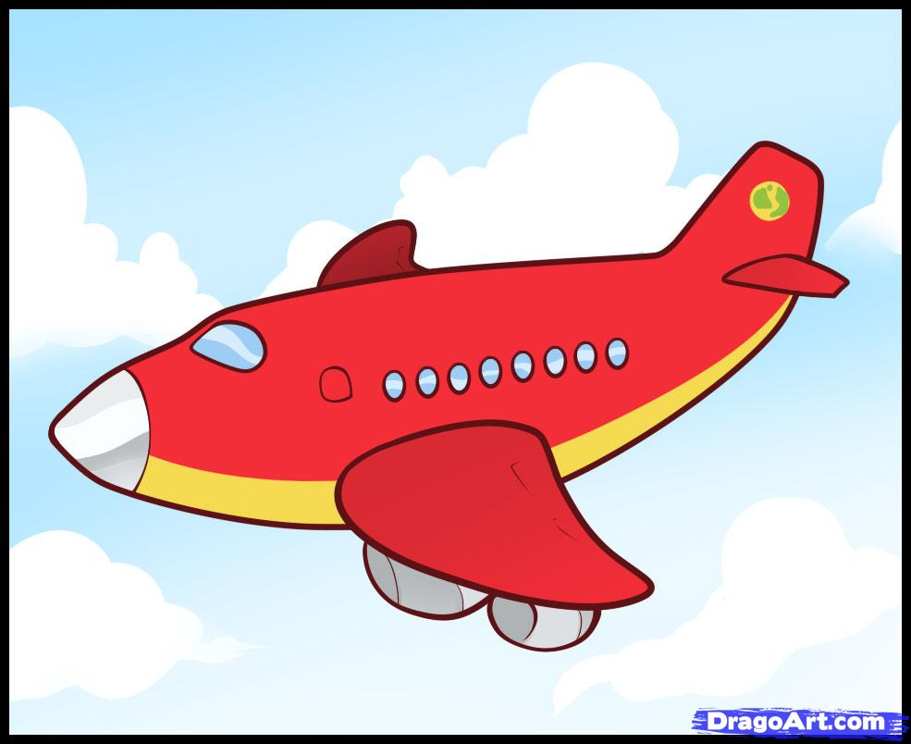
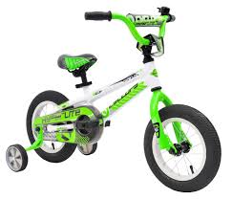
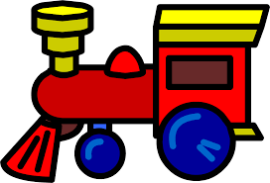


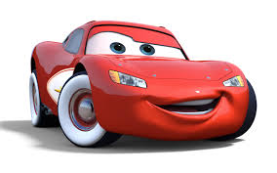
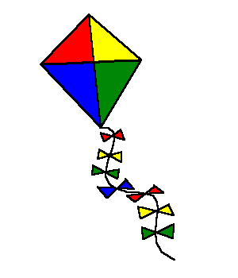
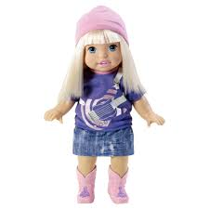

Slide 4
Цели и задачи
Субкомпетенция: совершенствовать знания учащихся по теме “My toys”, “Colours”
1.О1: развивать умения и навыки устной речи, обеспечить закрепление лексического материала по теме, создать условия для применения знаний .
2.О2: развивать интерес к изучению английского языка, развивать умения во всех видах речевой деятельности, умение работать в паре, развитие творческих способностей.
3. О3: Воспитывать культуру общения.

Slide 5
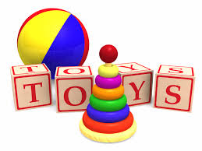
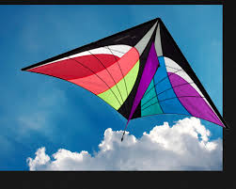

Vocabulary
Toys [tɔɪs] -
Kite [kaɪt] -
Bike [baɪk] -
игрушки
воздушный змей
велосипед

Slide 6
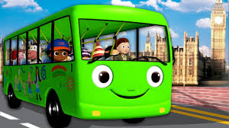
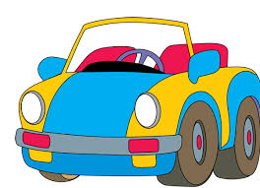
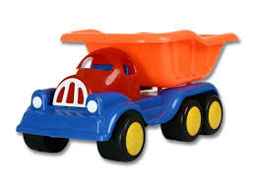
Bus [bʌs] –
Car [kɑː] –
Lorry [ˈlɔrɪ]–
автобус
машина
грузовик

Slide 7
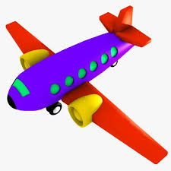
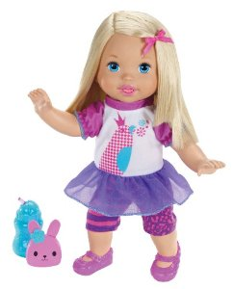
Train [treɪn] -
Plane [pleɪn] -
Doll [dɔl]-
поезд
самолет
кукла

Slide 8
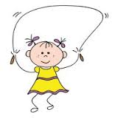
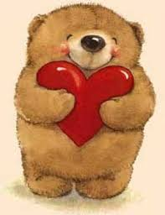
Rope [rəʊp] –
I love toys [Aɪ lʌv tɔɪs ] –
скакалка
Я люблю игрушки.

Slide 9
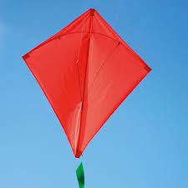

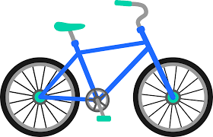
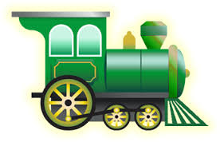
Let’s go to sing a “Toys Song”

Slide 10
EXERCISE 1(individually)
Put the missing letter.
DOL…
B..KE
P..AN..
B…S
C…R
TRA..N
I, L, A, L, E, I, U,

Slide 11

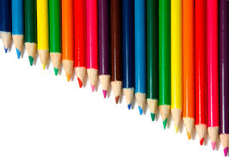
Do you know colours?
Let’s watch, listen and repeat.

Slide 12
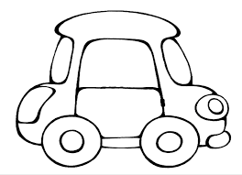
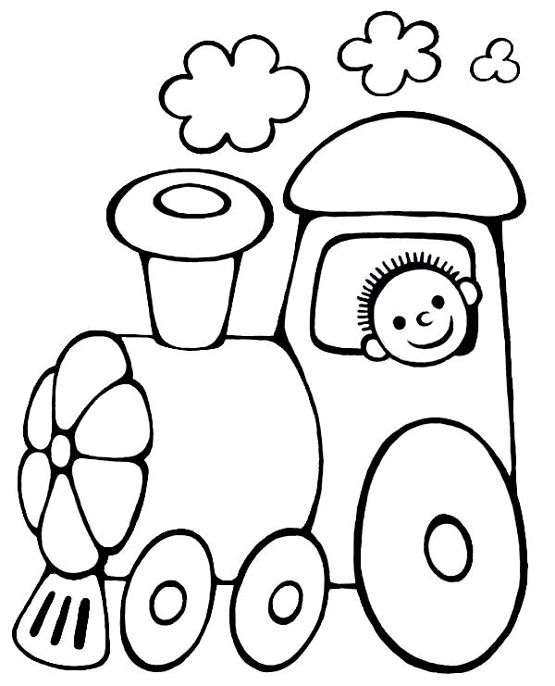
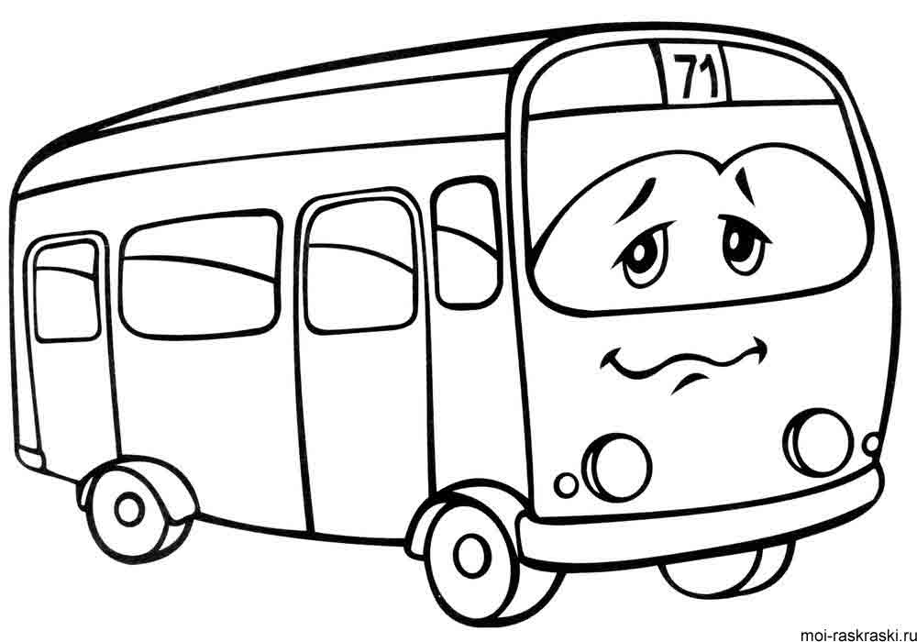
EXERCISE 2
READ and color the pictures.
It is a car . It is red and yellow.
It is a train. It is green.
It is a bus. It is blue.

Slide 13
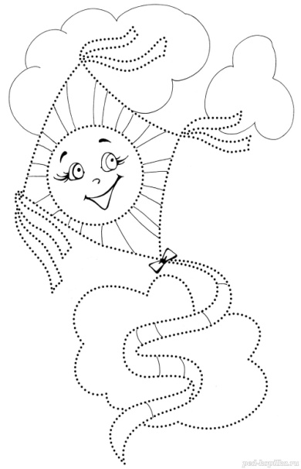

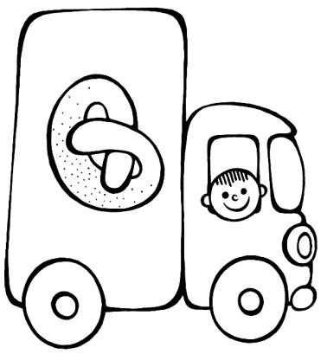
It is a kite. It is red, green and pink.
It is a bike. It is blue and orange.
It is a lorry. It is brown and blue.

Slide 14
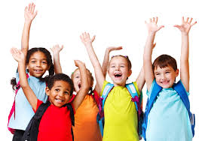
Moving activity
Hands up clap, clap, clap,
Hands down shake, shake shake
Hands on hips jump, jump jump
Stand still, please, sit down.

Slide 15

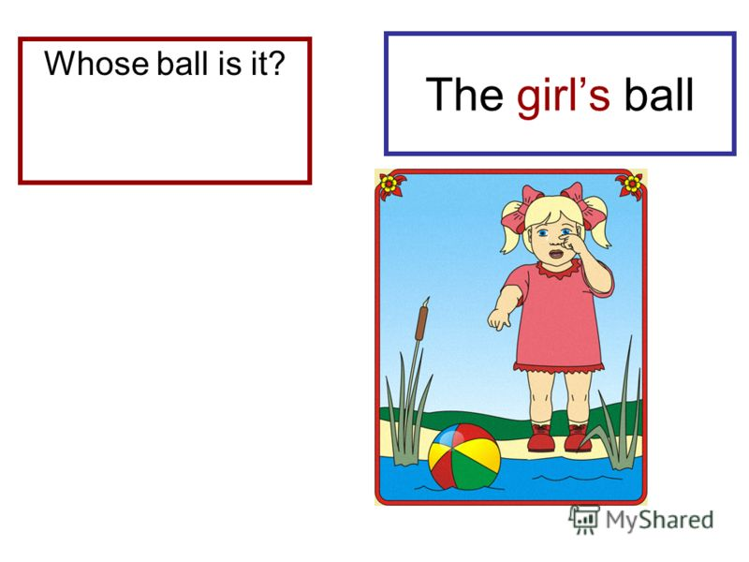
POSSESSIVE CASE
Для того чтобы сказать, чьё это имя, кому принадлежит какая-либо вещь, к существительному или имени собственному добавляется
For example: Tim’s bus is green.
Ann’s kite is big.

Slide 16
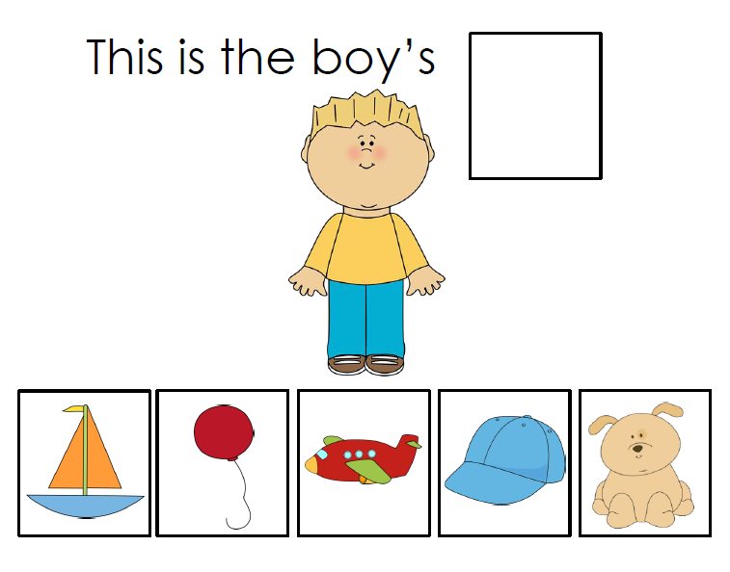
EXERCISE 3 (individually)
Complete the sentences.
Dog
Plane
Cap
Boat
Balloon

Slide 17
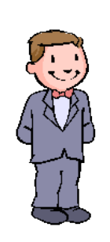
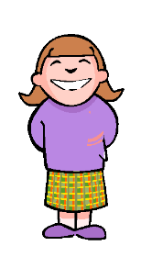
Exercise 4 put the sentences in the right order.(pair WORK)
- Hello.
- My name is Ann.
- My favorite toy is train.
- And my name is Tim.
- What color is it?
- What’s your name?
- It is green and yellow.
- Hello.
- What’s your favorite toy?
- Hello.
- Hello.
- What’s your name?
-My name is Ann.
- And my name is Tim.
- What’s your favorite toy?
- My favorite toy is train.
- What color is it?
- It is green and yellow.

Slide 18
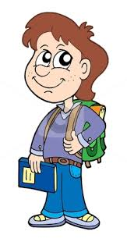
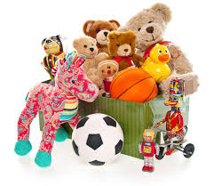
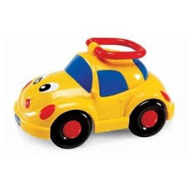

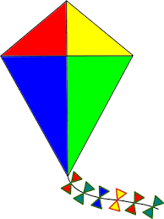
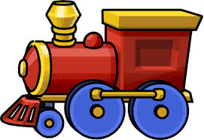

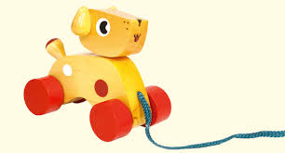
Exercise 5:( WORK IN PAIRS)
Complete the sentences and read the letter.
My name is Tim. I am a . I have many :
a , , a , a , a and a
green .
I like to play with my toys very much.
What is your favorite ?
Bye,
Tim.
pupiltoysbikekitetraincarbustoy

Slide 19
Check the answer.
My name is Tim. I am a pupil. I have many toys: a bike, a kite, a train, a car and a green bus.
I like to play with my toys very much.
What is your favorite toys ?
Bye,
Tim.

Slide 20
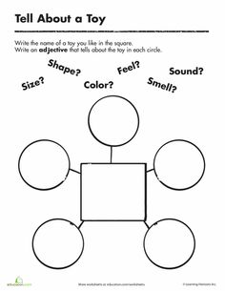
Home work.
Describe your favorite toy.

Slide 21




Slide 22



I AM SELF-SATISFIED. THE RESULT OF MY WORK was GOOD.
(Я ДОВОЛЕН СОБОЙ И РЕЗУЛЬТАТАМИ СВОЕЙ РАБОТЫ.
Some tasks were difficult, but I coped with them.(некоторые задания были трудными, но я справился с помощью учителя.
I was bored. I sat and waited for the break. (Мне было скучно. Я сидел и ждал звонка.)

Slide 23
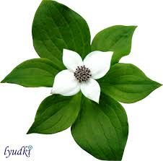


I AM SELF-SATISFIED.
Some tasks were difficult.
I was bored. I sat and waited for the break.

Slide 24
Thank you, my dear friends! Good-bye!
See you!

