Slide 1

PROFESSIONS
What is your father?
Grade 2
Teacher
Kunceva Tatiana Ivanovna

Slide 2

Vocabulary

Slide 3
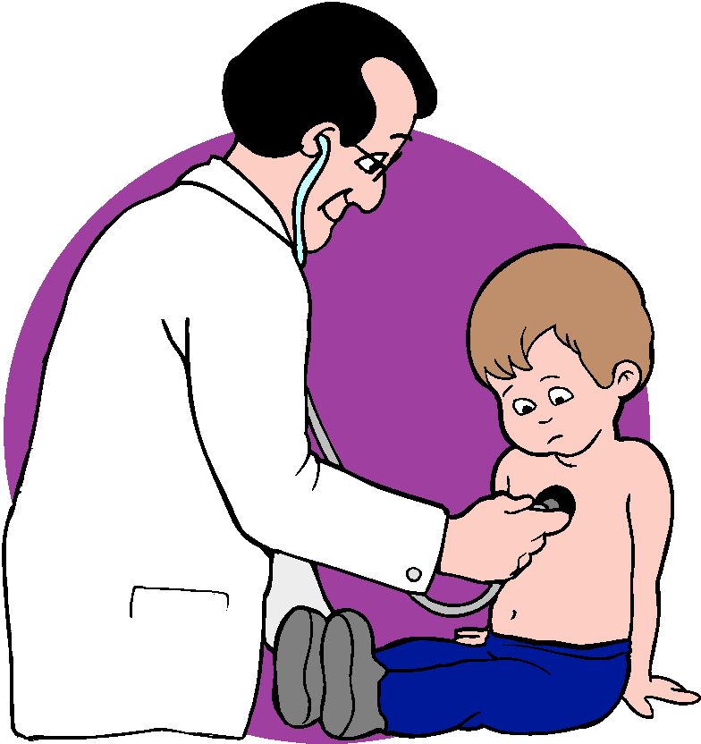
доктор
a doctor - [ˈdɔktə]

Slide 4

a teacher-[ˈtiːʧə]
учитель

Slide 5
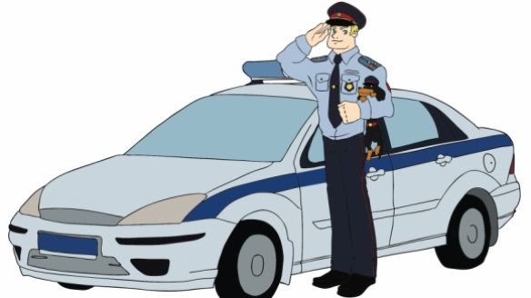
a policeman -[pəˈliːsmən]
полицейский

Slide 6
a farmer - [ˈfɑːmə]
фермер

Slide 7
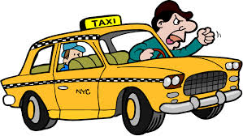
A driver - [ˈdraɪvə]
водитель

Slide 8
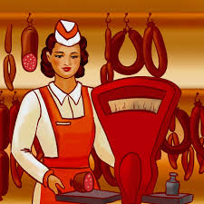
A shop-assistant - [ʃɔp əˈsɪstənt]
продавец

Slide 9

A programmer – [ˈprəʊgræmər]
программист

Slide 10
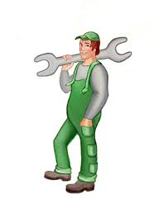
A mechanic - [mɪˈkænɪk]
механик

Slide 11

хозяйка
A housewife - [ˈhaʊswaɪf]

Slide 12
What is your father?-
[wɔt iz jɔː fɑːðə]
Кто твой отец по профессии?

Slide 13
What is your father?-
[wɔt iz jɔː fɑːðə]
Кто твой отец по профессии?
My father is driver.-
Мой отец водитель.

Slide 14


Repeat and translate.
I am a pupil.
You are a driver.
She is a teacher.
He is a mechanic.

Slide 15
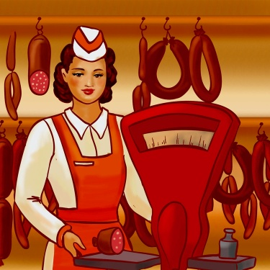


Unscramble the words
rotcdo
chteare
verdri
merfar
mmerprogra
Sistant shop-as
manpolice
wifehouse
hanicmec

Slide 16
Answer
rotcdo
chteare
verdri
merfar
mmerprogra
Sistant shop-as
manpolice
wifehouse
hanicmec
Doctor
Teacher
Driver
Farmer
Programmer
Shop-assistant
Policeman
Housewife
mechanic

Slide 17
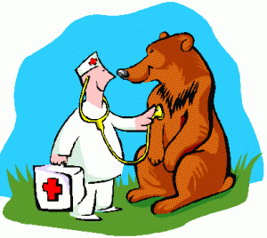
Who works in a hospital?

Slide 18

Who works in a school?

Slide 19
Who works in a police station?

Slide 20
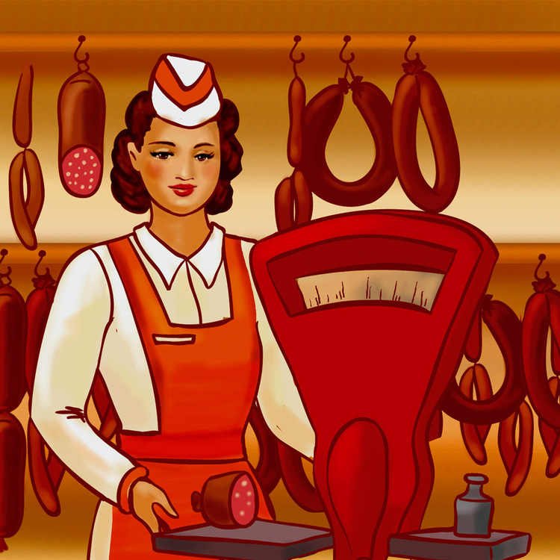
Who works in a shop(магазин)?

Slide 21
Who works at home?

Slide 22
Correct the mistakes
My mother is a driver .
My father is a policeman .

Slide 23
Correct the mistakes
My brother is a farmer .
My sister is a housewife .

