Slide 1
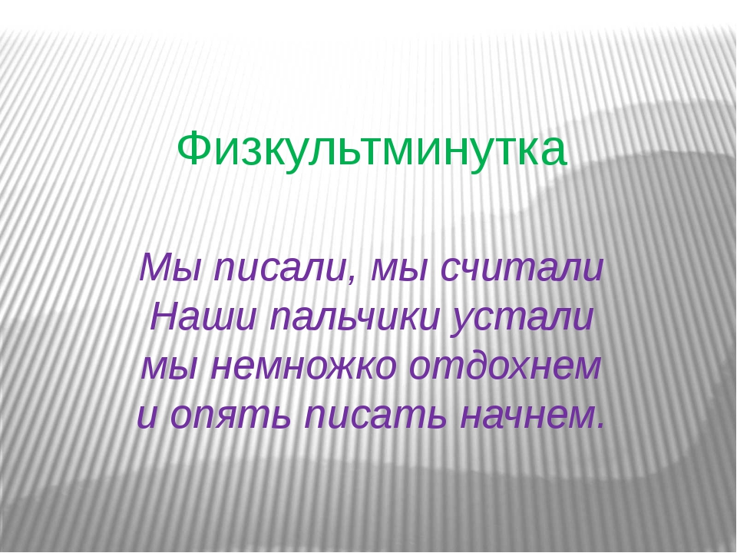

Slide 2
We wrote, we wrote,
Our fingers were tired.
Let’s have a break
And then we’ll write again!

