Slide 1
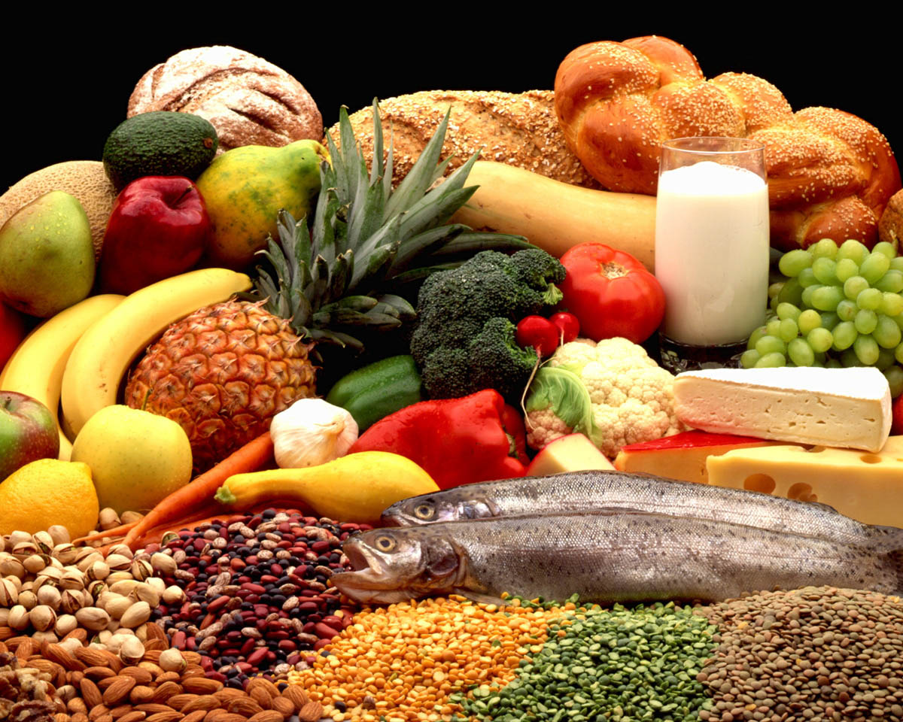
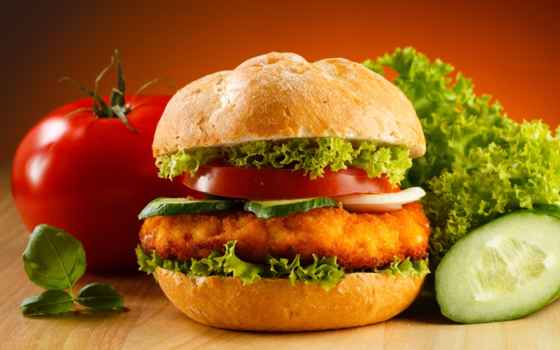
Food
How much?
How many?

Slide 2

1. Организационный момент
- What date is it today?
- What day of the week is it today?
- What season is it today?
- What is the weather like today?

Slide 3
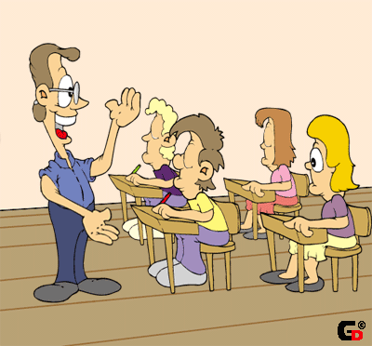
2. Фонетическая зарядка
[t] - tea, water, meat, biscuits, sandwich
[s] - sausage, soup, juice
[n] - honey, banana, lemon
[dʒ ] - porridge, sausage, juice.

Slide 4

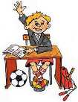
Repeat the rhyme
Some of us like brown bread,
Some of us like white,
Some of us eat a lot of meat,
Some don’t think it’s right.
Some of us like apples,
Some drink juice at night,
Some of us eat many sweets,
Some don’t think it’s right.

Slide 5

Создание проблемной ситуации
У меня много …
I have got ____ friends.
I have got ____ money.
I have got ____ relatives.
Когда у вас много всего – это хорошо. Особенно, если дело идет о друзьях, деньгах и родственниках. Но как грамотно рассказать об этих радостях по-английски?

Slide 6
  Работа с микродиалогами
a)- You look terrible! What is the matter?
- I drank too much juice this morning.
- How much juice did you drink?
- I drank so much juice that I am never going to drink juice again.
b)
- You look terrible! What is the matter?
- I ate too many cookies last night.
- How many cookies did you eat?
- I ate so many cookies that I am never going to eat a cookie again.

Slide 7
Примерные вопросы для обсуждения
What is common about these sentences?
- They start with the words: “How much, how many”.
What is the difference between them?
- “How much” is used with the words – juice, cheese.
- “How many” is used with the words – sandwiches, cakes.
What kind of nouns are the words – juice and cheese? Can we count them?
- No, we can’t. They are uncountable nouns.
What kind of nouns are the words – sandwiches, cakes? Can we count them?
- Yes, we can. They are countable nouns.

Slide 8
Речевая практика
Look at the blackboard. Name the products. Divide all nouns into 2 groups (countable-uncountable).
Water, apples, milk, sweets, juice, oranges, coffee, bananas, tea, eggs, soup, carrots, porridge, cups of tea or coffee, bread, cheese, glasses of milk or juice, fruits, meat, fish, jam, chocolate, hamburgers.

Slide 9
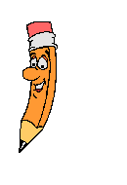
let’s check the exercise
Countable | Uncountable
apples sweets oranges bananas eggs carrots cups of tea or coffee cheese glasses of milk or juice fruits fish chocolate hamburgers | Water juice coffee tea soup porridge bread cheese meat Jam milk

Slide 10


Let’s do the next exercise. Choose the right variant
(How many, how much ) cups of tea do you drink at breakfast?
(How many, how much) glasses of juice does your brother drink every day?
(How many, how much) jam does she eat at breakfast?
(How many, how much) salad do you eat at dinner?
(How many, how much) bread does he eat at supper?
(How many, how much) cheese do you eat at lunch?
(How many, how much) chocolate does she eat every day?

Slide 11

Let’s check
How many cups of tea do you drink at breakfast?
How many glasses of juice does your brother drink every day?
How much jam does she eat at breakfast?
How much salad do you eat at dinner?
How much bread does he eat at supper?
How much cheese do you eat at lunch?
How many chocolate does she eat every day?

Slide 12
Now make up the questions
1.Much how is there salt
2.Water much how there is
3.Many how there are sweets
4.Hamburgers are there many how
5.Much salad how is there
6.Eggs many there are how
7.Much how there is meat

Slide 13

Let’s check
How much meat is there?
How many eggs are there?
How much salad is there?
How many hamburgers are there?
How many sweets are there?
How much water is there?
How much salt is there?

Slide 14
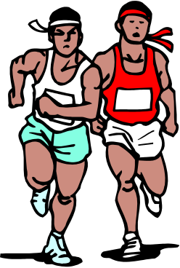

Action time
Посмотрите птичка bird
Например она дает
Чтобы небо ближе стало
Делай up и делай down
Прибежала кошка cat
тоже хочет дать совет
чтоб как я вам гибкой стать
наклоняйтесь left and right

Slide 15
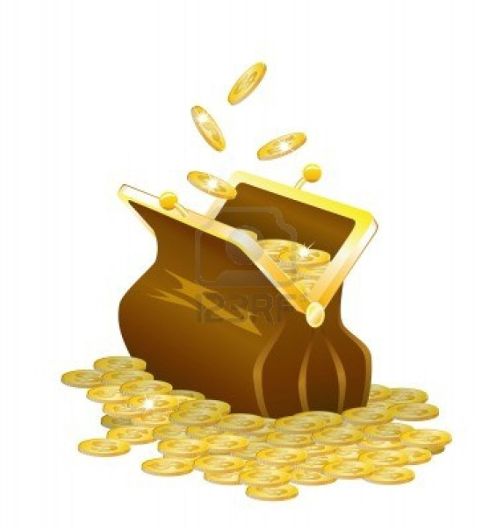
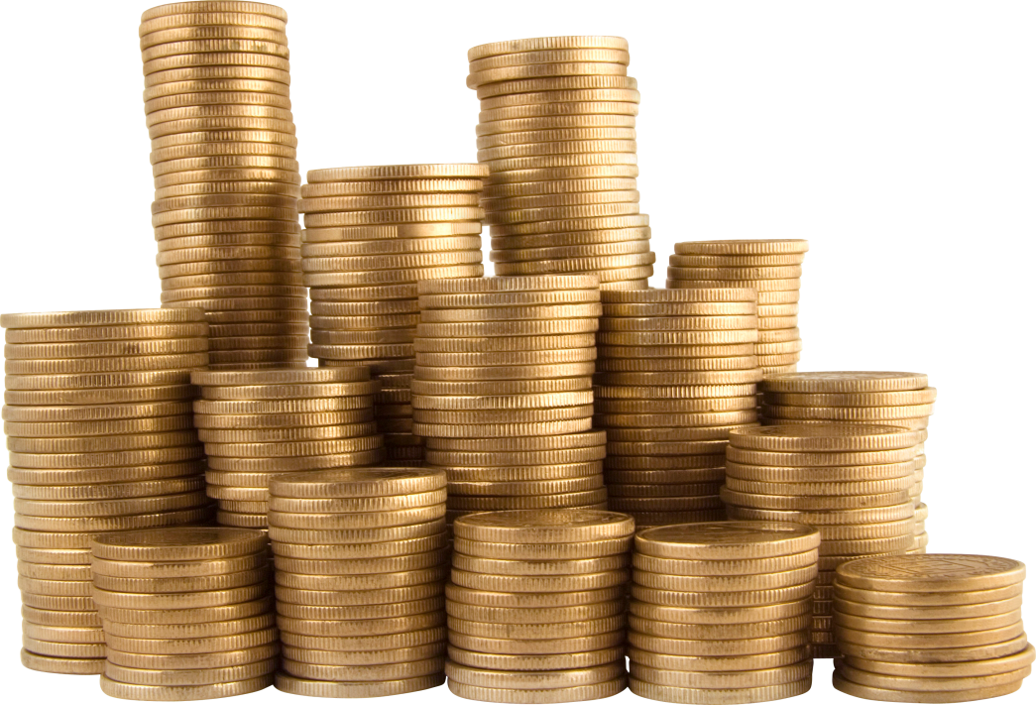
Remember that the word “money” in English is an uncountable noun.

Slide 16
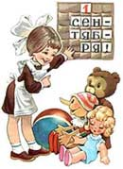

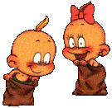
Развитие навыков диалогической речи
Make up the dialogues:
Ask your classmate how many books are in his bag.
Ask your classmate how much homework he has for tomorrow.
Ask your classmate how many pens are on the table.

Slide 17
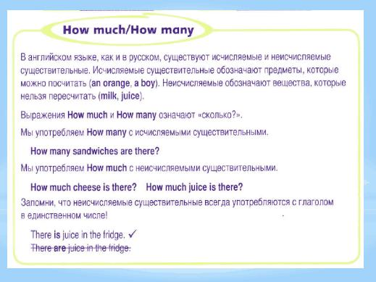
Ознакомление с новым грамматическим материалом, выявленным учащимися в процессе урока.

Slide 18


Возврат к начальной стадии урока, решение поставленной проблемной задачи. Обобщение и подведение итогов урока
I have got (many, much) friends
I have got (many, much) subjects
I have got (many, much) sweets
I have got (many, much) money

Slide 19
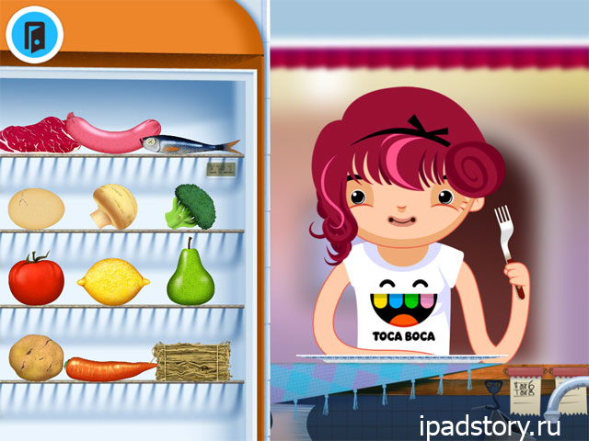
Home Work
Tell your friends what you have in your fridge
F. ex: I have got many eggs in my fridge.
I have got much mineral water in my fridge.
(At least 7 sentences).

Slide 20
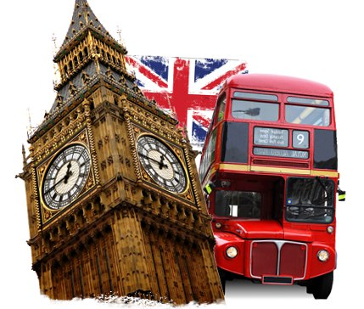
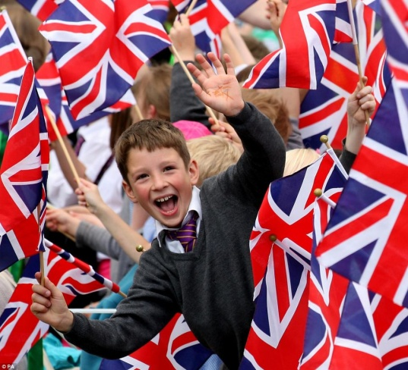
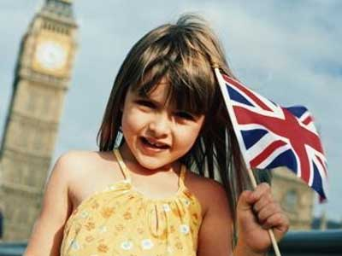
Ознакомление учащихся с реалиями английского языка
“So many men, so many minds” (Сколько людей, столько и мнений);
“How much is it?” (Сколько это стоит?);
“So much for that” (Ну, хватит об этом!)

Slide 21



What Emotions Do You Feel?
Positive Emotions Negative Emotions I Feel…
Satisfaction
Happiness
Success
Proud
Joy
Unsatisfaction
Sadness
Fear
Tired
Why?
Because I…
worked hard
didn’t relax
Was active
Got a good (bad) mark

Slide 22


Итог урока
Thanks for your attention

