Slide 1



Slide 2
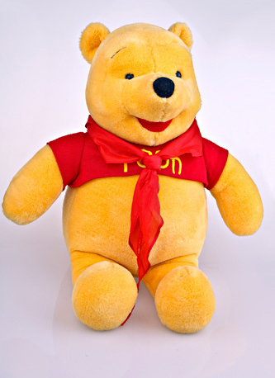
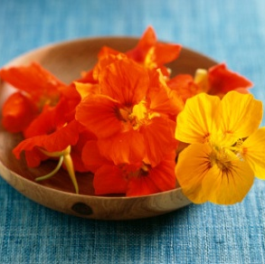
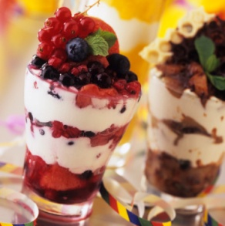

I CAN SEE ….

Slide 3
HAPPY BIRTHDAY!
Wondershare software

Slide 4
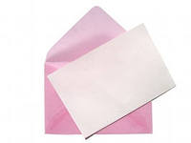

Dear friends!
Please, come to my birthday party
On the 13 th of February
At school №6
From Mark
P.S. I’m 12

Slide 5
Our plan
Повторяем то, что знаем
Фонетическая зарядка
Составление сценария
Приглашение на праздник
Физкультминутка
Сюрприз
Это интересно

Slide 6
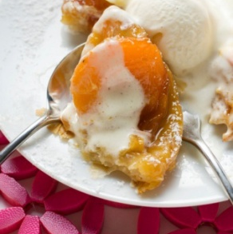
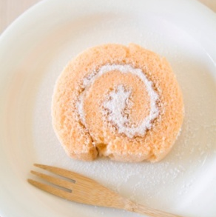
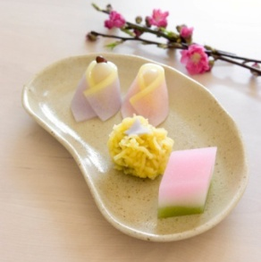
Our plan
Фонетическая зарядка
Повторяем то, что знаем
Это интересно
Физкультминутка
Составление сценария
Приглашение на праздник
Сюрприз

Slide 7

Фонетическая зарядка
Enjoy Listening and Playing - 3 кл\start.exe

Slide 8
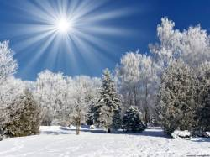

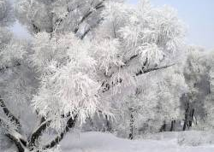
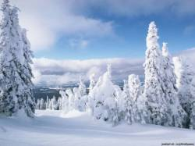
WINTER
DECEMBER
[dı'sembə]
JANUARY
['ʤænjuərı]
FEBRUARY
['februərı]

Slide 9
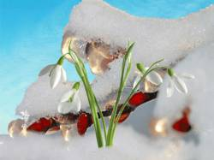
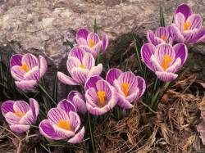
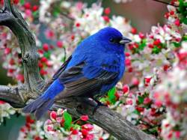
SPRING
MARCH
[‘mɑʧ]
APRIL
['eıpr(ə)l]
MAY
[‘maı]

Slide 10

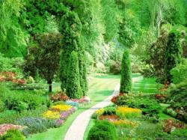
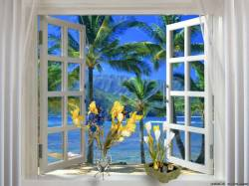
SUMMER
JUNE
[‘ʤun]
JULY
[ʤu(:)'laı]
AUGUST
[ɔ'gʌst]

Slide 11
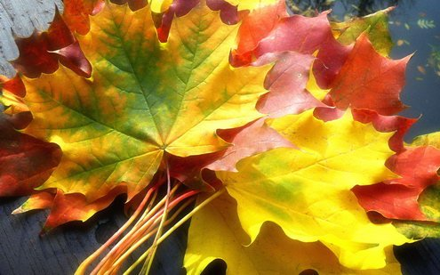
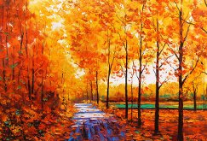
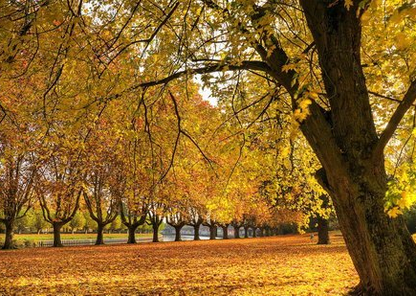
AUTUNM
SEPTEMBER
[sep'tembə]
OCTOBER
[o̷k'təubə]
NOVEMBER
[nəu'vembə]

Slide 12
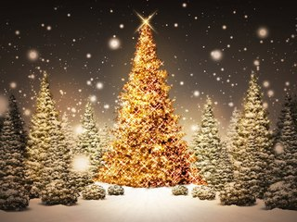
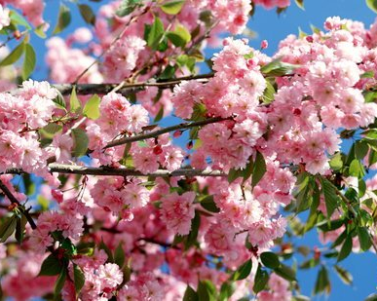

SEASONS
WINTER
SPRING
SUMMER
AUTUMN
DECEMBER
MARCH
JUNE
SEPTEMBER
SCHOOLL
JANUARY
FEBRUARY
APRIL
MAY
JULY
AUGUST
OCTOBER
NOVEMBER

Slide 13
-When is your birthday?
-My birthday is in …

Slide 14
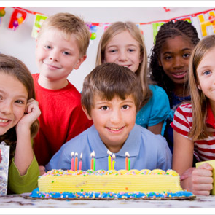
HAPPY BIRTHDAY!

Slide 15
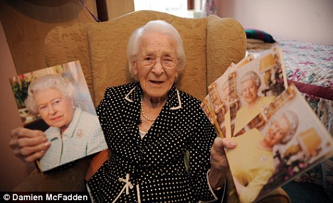
HAPPY BIRTHDAY!

Slide 16
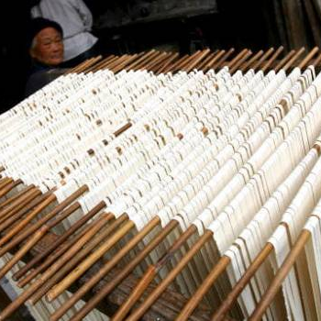
HAPPY BIRTHDAY!

Slide 17
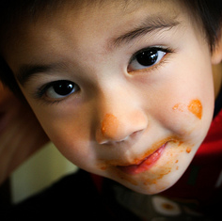
HAPPY BIRTHDAY!

Slide 18
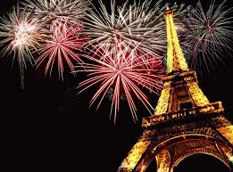
HAPPY BIRTHDAY!

Slide 19
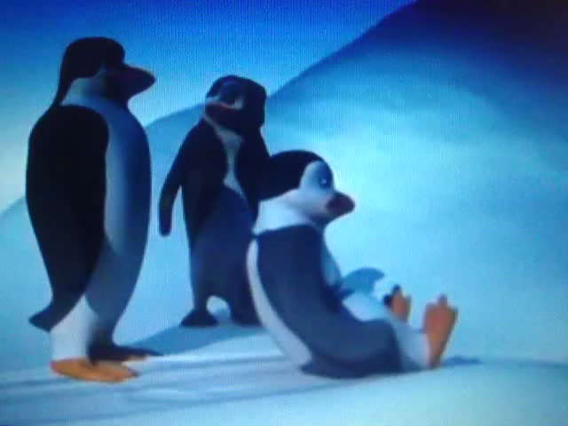
Физкультминутка

Slide 20

Let’s have a party!
My birthday’s plan:
We play games
We buy presents
We sing songs
We recite poems
We dance
We have fun

Slide 21
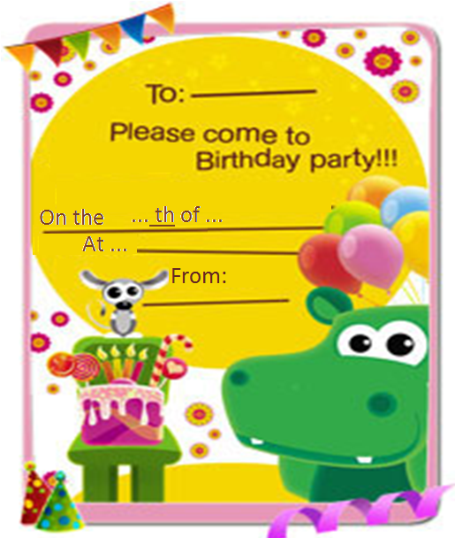
Mark
7
July
school №2
Inga

Slide 23



Slide 24
Thanks!

