Slide 1
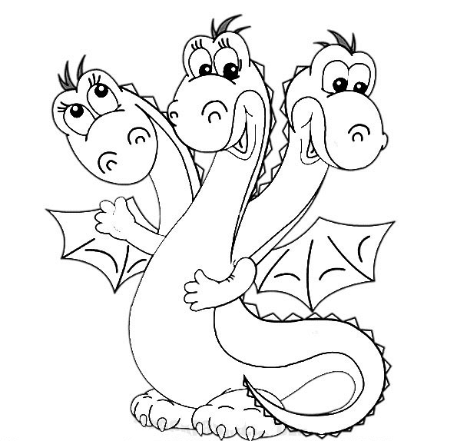
he/she/it
we/you/they
I
am
is
are
To be (быть)

