Slide 1
Revise your home task.

Slide 2
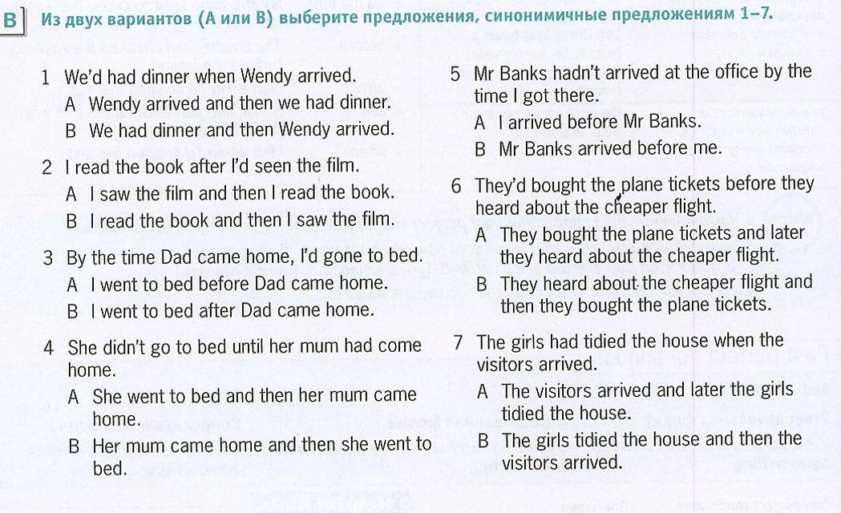

Slide 3
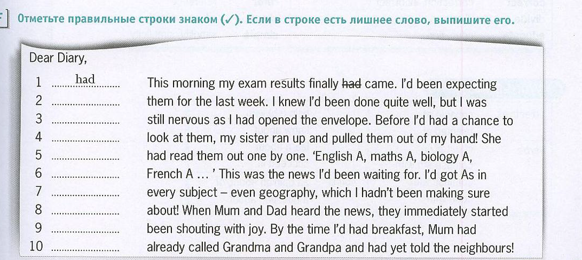

Slide 4
Conditionals
The first conditional ( условное предложение 1-го типа)
The second conditional ( условное предложение 2-го типа)

Slide 5
The first conditional We can talk about a future situation and its consequences
If you take these pills, you will start to feel better very soon.
If Mum is tired tonight, I will cook dinner.
If I don’t get a good mark in the geography test, I will be very annoyed.
If you see Lisa, will you ask her to call me?
IF The PRESENT SIMPLE, The FUTURE SIMPLE.
action result

Slide 6
We use the first conditional to predict the result of an action.
We use The Present Simple to describe the action , and The Future Simple to describe the result. If I get a job , I will have to move to another town.
I think you will do well in the interview if you are confident.
If Verb ( base form)/ Verb (s), will / won’t Verb( base form)
IF don’t /doesn’t VERB ( base Form), will Verb ( base form).

Slide 7
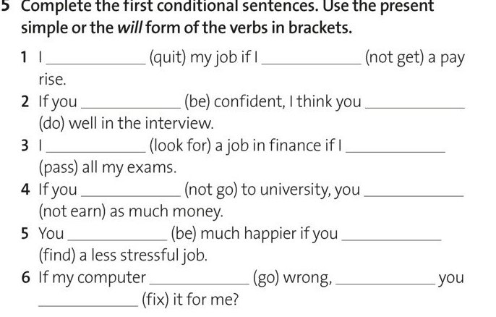

Slide 8
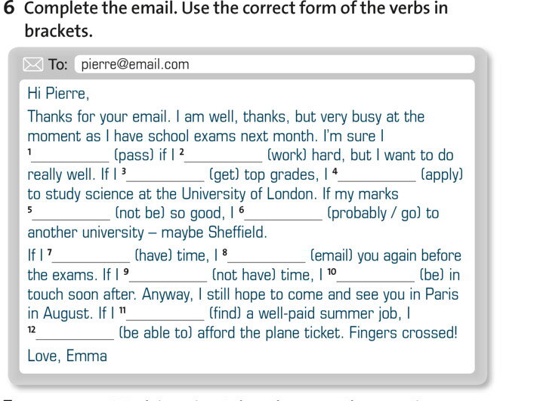

Slide 9
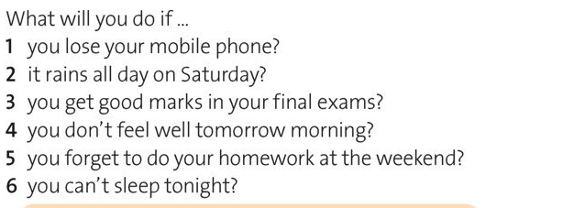
Answer the questions

