Slide 1
MODALS
SHOULD ,MUST, MUSTN’T, HAVE TO, DON’T HAVE TO (NEEDN’T)

Slide 2
PROBLEMS, PROBLEMS….
SHOULD – WE GIVE ADVICE

Slide 3
Problem:
I borrowed my friends camera and I broke it. Should I be honest about it?
Or should I say that someone else broke it? What do you think?
Did you ever have a similar experience ? What did you do?

Slide 4

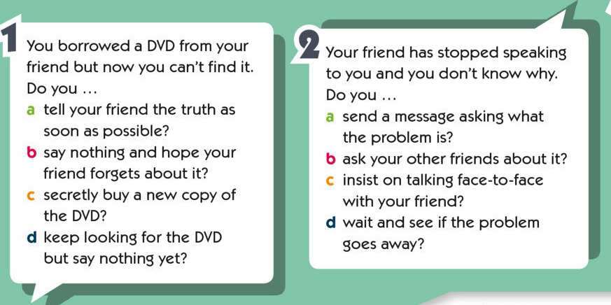

Slide 5
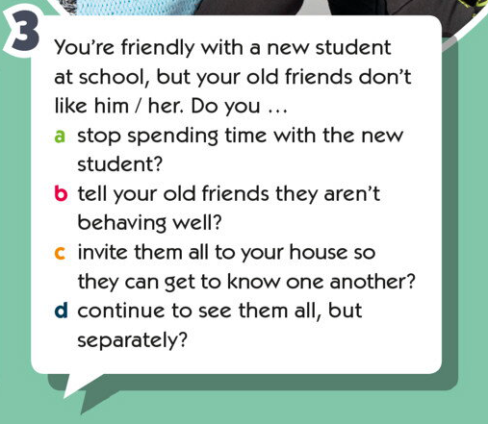

Slide 6
OBLIGATION and NECESSITY
HAVE TO and MUST
DON’T HAVE TO ( NEEDN’T)

Slide 7
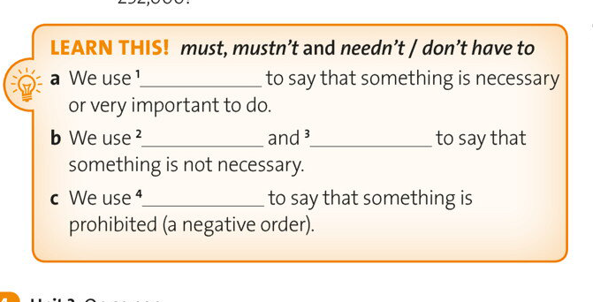

Slide 8
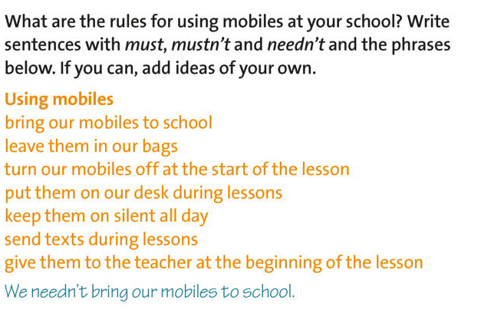

Slide 9
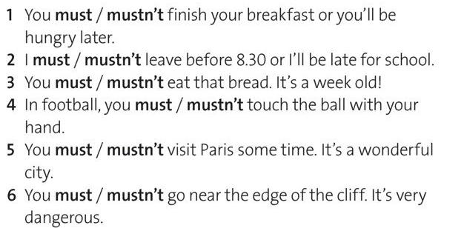

Slide 10
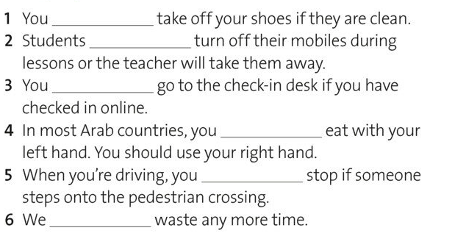

Slide 11
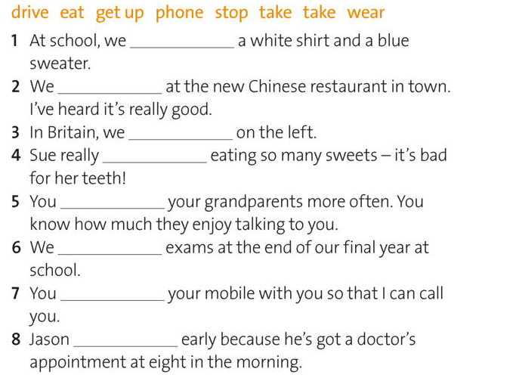

Slide 12
Модальные глаголы
https://www.youtube.com/watch?v=iw5x74HPsVg

