Slide 1
Conditionals
Second Conditional ( Условное предложение 2 типа).
Для выражения воображаемой ситуации в БУДУЩЕМ.

Slide 2
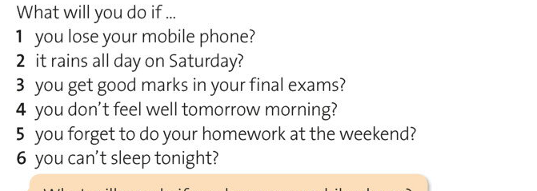
Answer the questions:

Slide 3
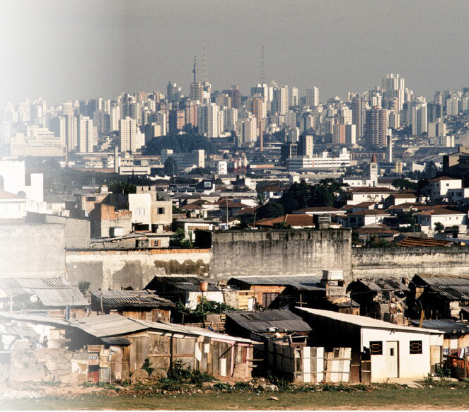
What can you see?

Slide 4
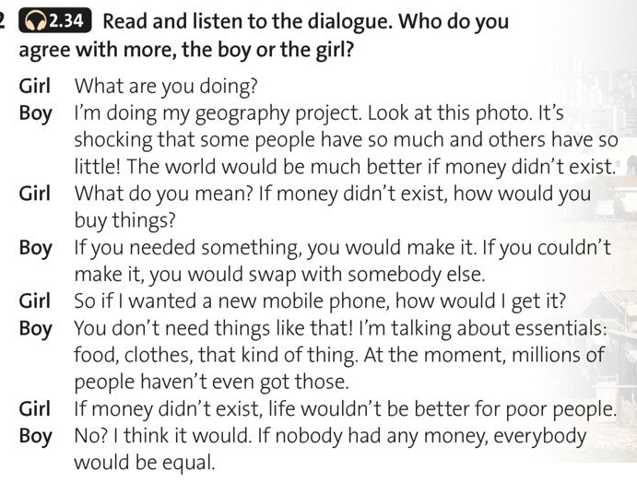

Slide 5
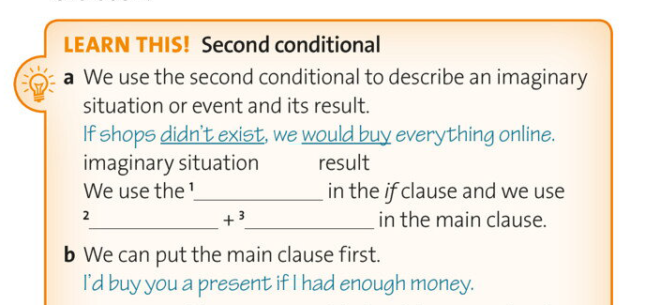

Slide 6
How we Form Second Conditional
Affirmative IF PAST SIMPLE, would VERB ( BASE FORM)
IF VERB (2)/ed, would Verb ( base Form).
If money didn’t exist, life would be better for poor people.
Negative
If didn’t V(base form), wouldn’t verb( base form)

Slide 7
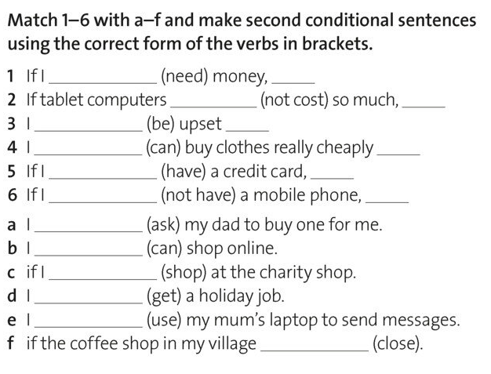

Slide 8
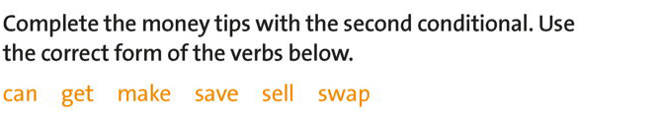


Slide 9
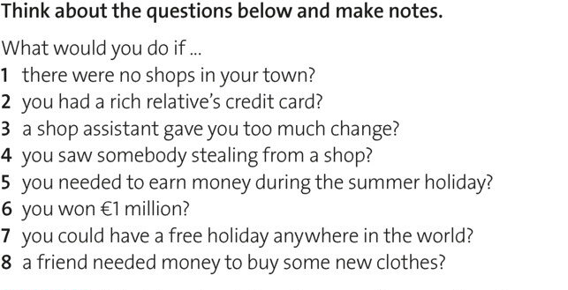

Slide 10
https://www.youtube.com/watch?v=VORGUNBlxwk
GOOD LUCK!

