Slide 1
Future forms
To be going to ( plans) I am going to do this task.
Present Continuous ( plans). I am meeting with my friends.
Will/ won’t verb( base form) Look at the clouds. It won’t rain.

Slide 2
Conditionals (условные предложения)
The first conditional ( условное предложение 1-го типа)
The second conditional ( условное предложение 2-го типа)

Slide 3
The first conditional We can talk about a possible future situation and its consequences.
Мы используем условное предложение 1-го типа для того , чтобы описать возможную ситуацию в будущем.
If you take these pills, you will start to feel better very soon.
If Mum is tired tonight, I will cook dinner.
If I don’t get a good mark in the geography test, I will be very annoyed.
If you see Lisa, will you ask her to call me?
IF The PRESENT SIMPLE, The FUTURE SIMPLE.
action result

Slide 4
We use the first conditional to predict the result of an action.
We use The Present Simple to describe the action , and The Future Simple to describe the result. If I get a job , I will have to move to another town.
I think you will do well in the interview if you are confident.
If Subject Verb ( base form)/ Verb (s), will / won’t Verb( base form)
IF Subject don’t /doesn’t VERB ( base Form), will Verb ( base form).
If Subject am, is,are object ( дополнение)

Slide 5
1. Match 1-6 with a-f to make sentences.
1.If we study hard,
2.If I got homework,
3.If my sister goes to London,
4. If we rehearse a lot,
5.If it doesn’t rain,
6.If she doesn’t practise the violin,
a the play will be good.
b she won’t play in the school orchestra.
c there will be a drought.
d we’ll pass our exams.
e I’ll do it before dinner.
f she’ll learn a lot of English.

Slide 6
Open the brackets:
1.If they ____(come) to the picnic , we____(have) a good time.
2.If she _____(phone),I _____(speak) to her.
3. There_____(be) floods, if it _____(rain) a lot.
4.If he _____( buy) a bicycle, he ____( cycle) to school.
5. You _____(pass) the exam if you ____( study) a lot.

Slide 7
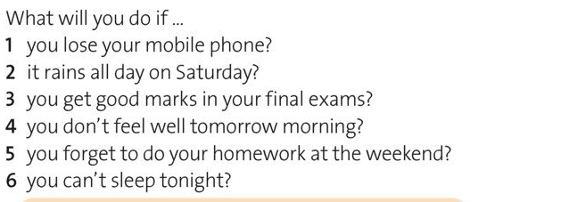
3. Answer the questions

Slide 8
Практикум
w/b p.45-46(3,4,5,6,7 ,8) https://www.youtube.com/watch?v=UIDmzYDnd1c

