Slide 1
Reported Speech
Косвенная речь
I can report what other people have said.

Slide 2

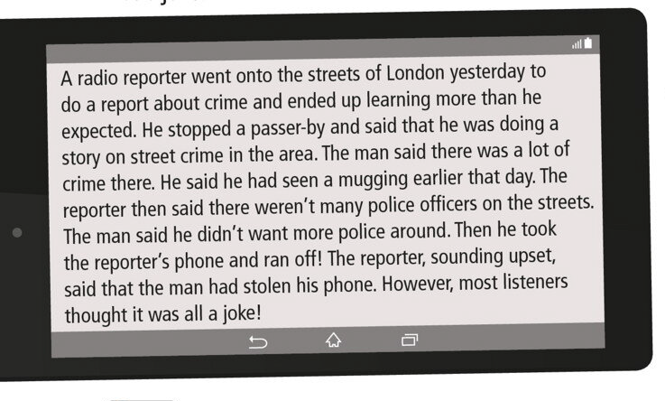

Slide 3
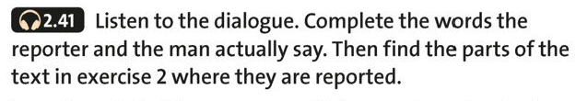
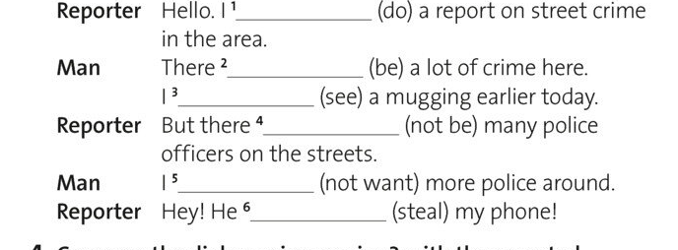

Slide 4
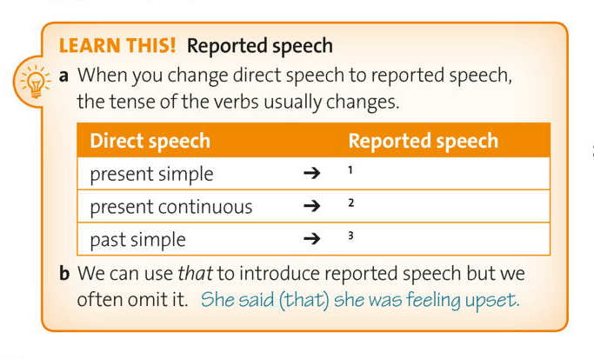

Slide 5
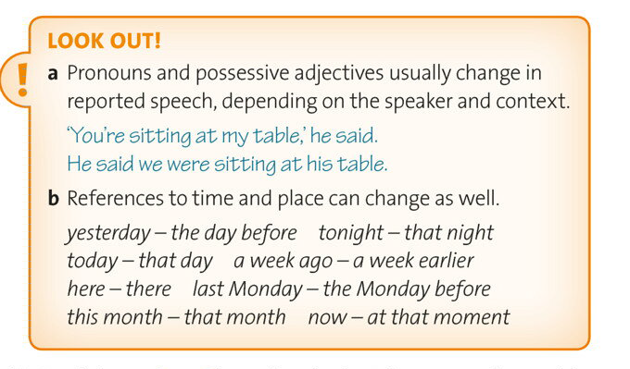

Slide 6
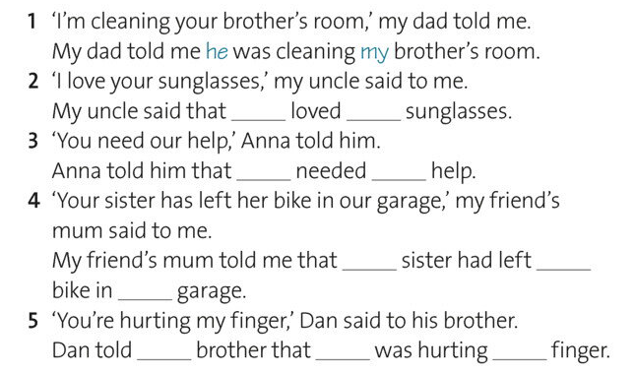
Complete the sentences with the correct pronouns and possessive adjectives

Slide 7
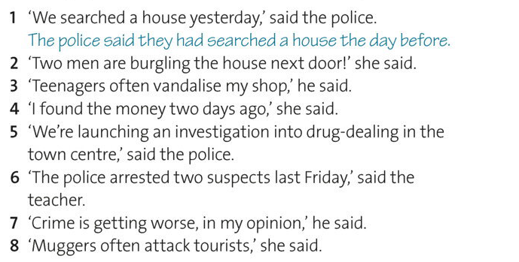

Slide 8
https://www.youtube.com/watch?v=rcxytsa8CbI

