Slide 1
The Passive ( present simple , past simple and future simple)
Пассивный залог в настоящем, прошедшем и будущем времени.

Slide 2
Look at the examples:
Our teacher gives us a lot of homework.
A lot of homework is given us . A lot of homework is given by our teacher.
2. The police arrests hundreds of criminals every year.
Criminals are arrested every year. Criminals are arrested by the police.
We use the passive when the action is more important than the person that does the action.

Slide 3
Read and translate these sentences:
Computers are sold in this shop.
The Olympic Games are held every four years.
The EURO isn’t used in America.
Every year, lots of money is donated to the children’s hospital.
Adverts are made in advertising agencies.
We use by if we think it is necessary to say who does the action.
Adverts are created by advertising agencies.

Slide 4

We use the passive when we do not know who or what performed the action, or we do not want to focus on who or what performed the action.

Slide 5

When we use adverbs with the passive, we usually put them before the Past Participle

Slide 6
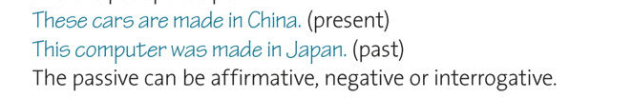
We form the passive with the correct tense of the verb BE and the Past Participle.

Slide 7
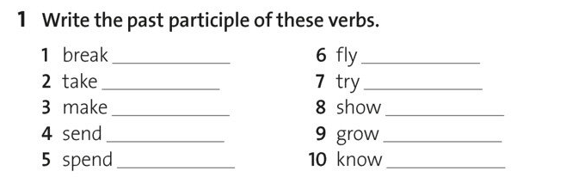

Slide 8
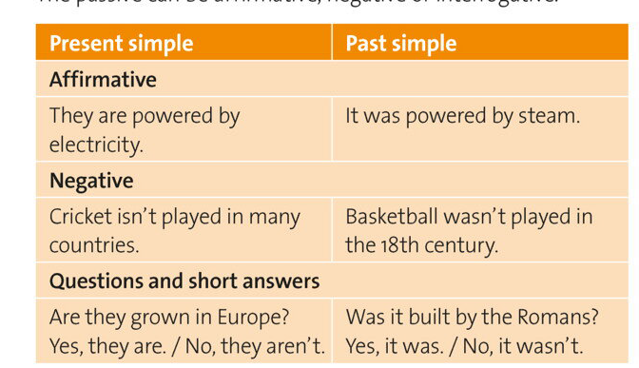

Slide 9
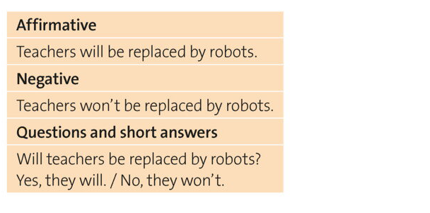
We form future passive like this: will/won’t +be+ past participle of the main verb.

Slide 10
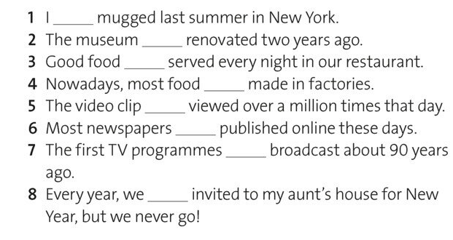
2. Complete the sentences with the correct form of the verb be

Slide 11
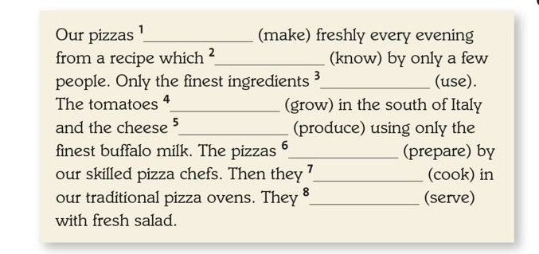
3. Complete the description using the Present Simple Passive form of the verbs in brackets.

Slide 12
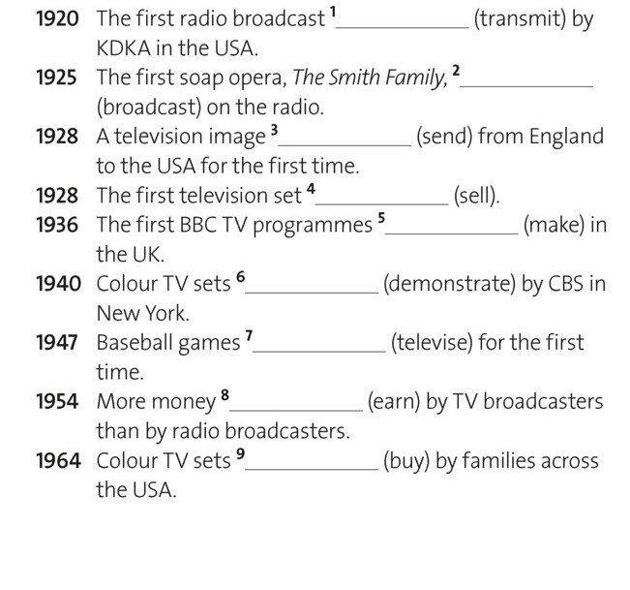
4. Complete the broadcasting facts. Use the Past Simple Passive form of verbs in the brackets.

Slide 13
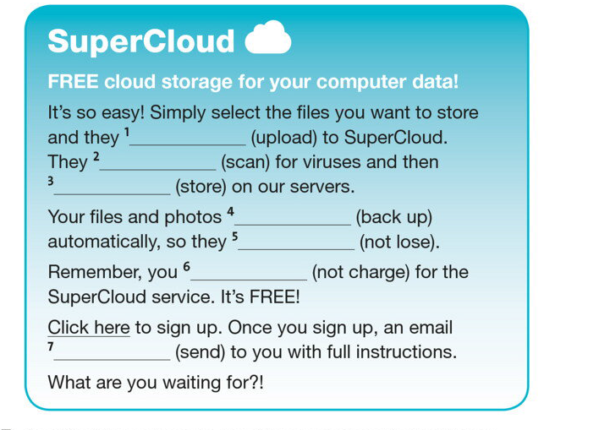
5. Complete the advertisement . Use the future passive form(will) of the verbs in brackets.

Slide 14
Задание на платформе learningApps.org
https://learningapps.org/view6052362
https://learningapps.org/view1938269

