Slide 1
writing An informal letter
You can write an informal letter

Slide 2

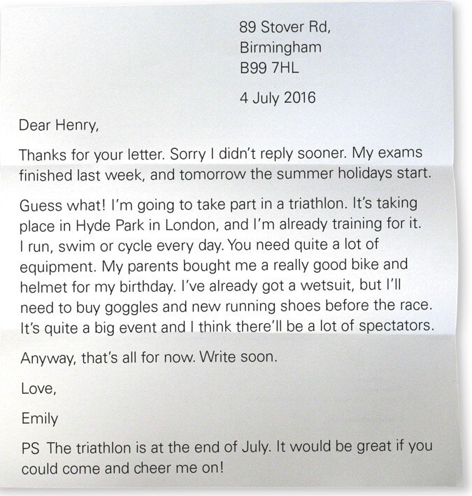

Slide 3



Slide 4

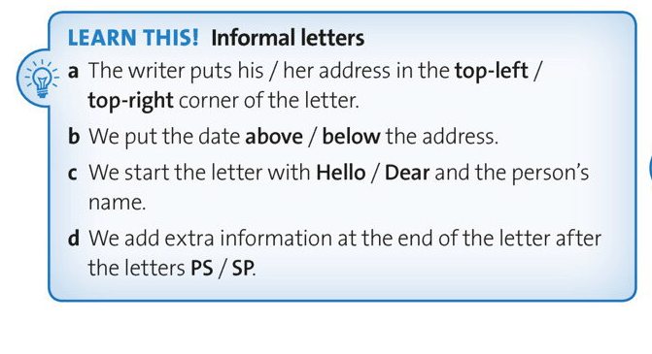

Slide 5
The rules for informal letter
1. Address
2. Date
3. Dear …,
4. Thank you very much for your letter.
5. Answer the questions.
6.Sorry, I have to stop( must stop), because …
7. Keep in touch.
8. Best wishes
9. Name (N)

Slide 6
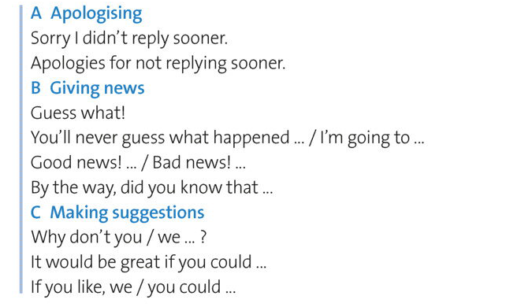
The phrases:

Slide 7
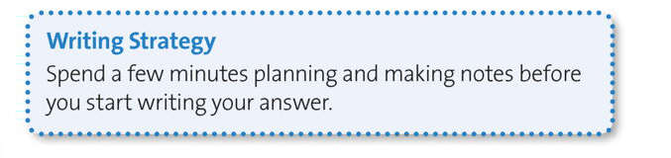

Slide 8
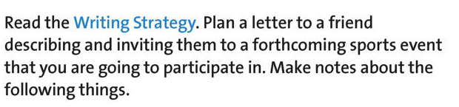
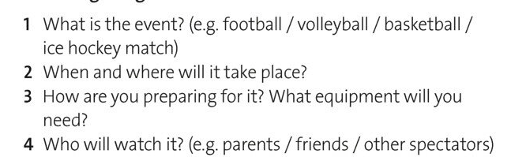

Slide 9


