Slide 1
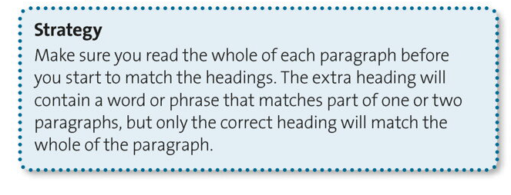

Slide 2



Slide 3

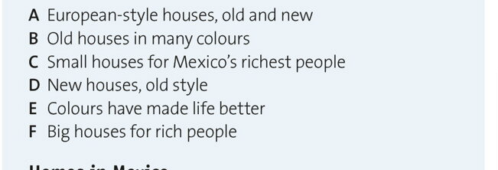

Slide 4

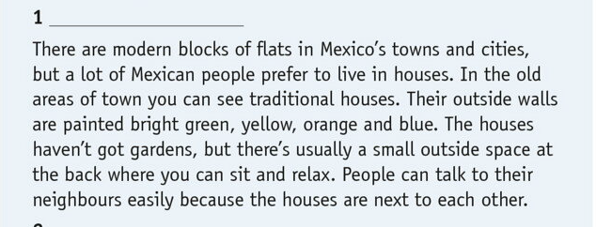

Slide 5


Slide 6


Slide 7


Slide 8


Slide 9



Slide 10
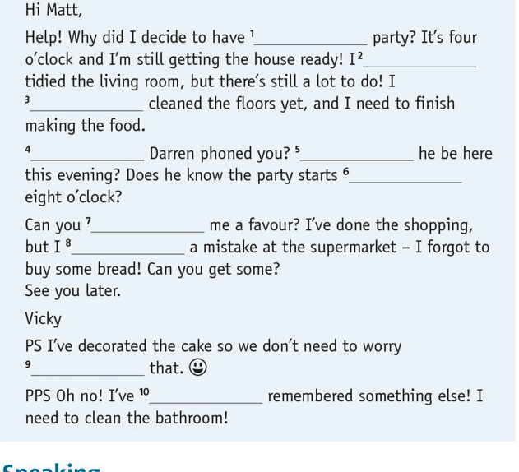

Slide 11
GOOD LUCK!

