Slide 1
English Grammar for 6th grade
Future Time
1-й способ выражения будущего времени:
Be going to ( собираться что-то делать)

Slide 2
Be going to употребляется для
Выражения планов и намерений;
Для описания ситуаций на основе увиденного;
Examples:
I am going to eat some sandwiches.
Look at the clouds! It’s going to rain.

Slide 3
When we talk about the future we can use be + going to + infinitive
Affirmative Form:
I am going to travel.
He/She/It is going to travel.
You/ We/ They are going to travel.
am/is/are + going + verb( base form)

Slide 4
Negative Form
Be + not+ going + infinitive
I am not going to travel.
He/She/It is not going to travel.
We/You/They are not going to travel.
Am/is/are + not+ going +to Verb ( base Form)

Slide 5
Question Form
Be +Subject + going to infinitive
Am I going to travel?
Is he /she/ it going to travel?
Are we/they/ you going to travel?
Am/Is/Are + I/he/she/you/we/they +going to+ Verb ( base form)

Slide 6
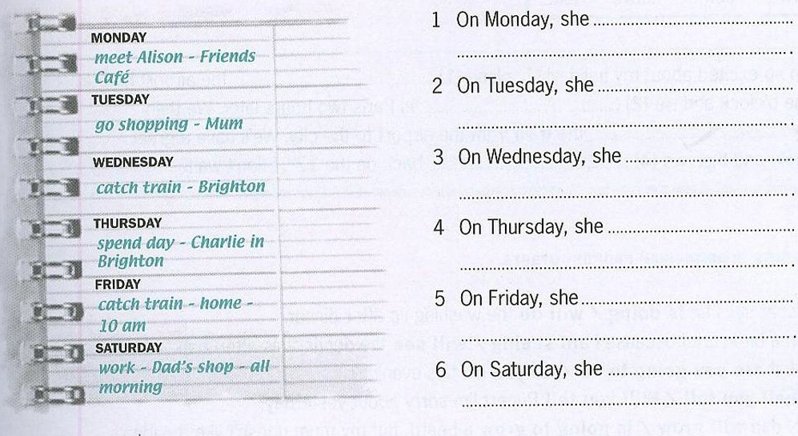
Task : Read Shelly’s dairy and write sentences with going to.

Slide 7
Задание ( Task) :
Составить 8 предложений о своих планах и намерений ( что вы собираетесь делать на этой неделе. What are you going to do at this week?

