Slide 1
How to talk about the past in English
Формы выражения прошедшего времени

Slide 2
The Past Tenses
Past simple
Past Continuous
Present Perfect
Past Perfect
English has different past verb forms to talk about the past in different ways.

Slide 3
Past Simple
1.oписать законченные действия в прошлом;
I saw the new film yesterday.
2. описать повторяющиеся действия в прошлом;
I went to the theatre four times last summer.
3.Описать последовательные действия в прошлом;
Josh pushed the door opened and looked inside the room an hour ago.

Slide 4
Time markers
Yesterday
Last week/ month/year/summer
In January/ 2001
An hour / a week/ a month/ ago

Slide 5
How we form Past Simple
Affirmative
Subject + Verb ( ed) / 2.
Negative
Subject+ didn’t + Verb ( base form).
Question
Did + Subject + Verb ( Base form) ?

Slide 6
Past Continuous употребляется для описания
Действий, которые происходили в определённый момент в прошлом; At 9 o’ clock last night I was watching TV.
Действий , одновременно происходящих в прошлом; I Iwas reading a book while you were doing washing-up.
Для описания фона событий в прошлом; We were sitting on the bus. It was raining. Yesterday evening, I was walking along the street.

Slide 7
Time markers ( past continuous)
While
At that moment
At one/ two/ three o’clock in the past.

Slide 8
How we form Past Continuous
Affirmative Subject was/were/+ Verb-ing-.
Negative Subject wasn’t/ weren/t + Verb ing-.
Question
Was / Were Subject + Verb – ing-?

Slide 9
Past Simple / Past Continuous
The phone rang while I was watching a DVD. Часто употребляются вместе для того, чтобы показать , что одно действие происходит во время другого.
Past Continuous не употребляется для описания регулярно повторяющихся действий.
Last year I was going to the cinema every weekend.( incorrect)

Slide 10
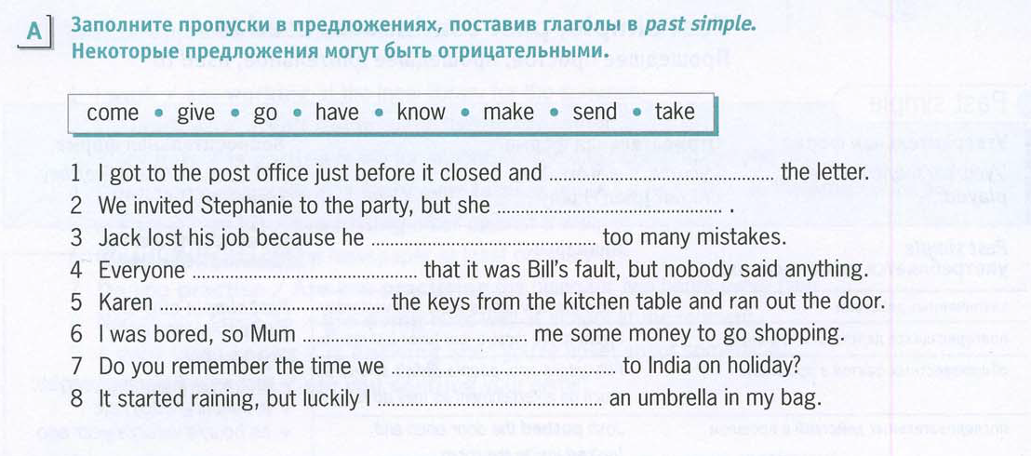

Slide 11
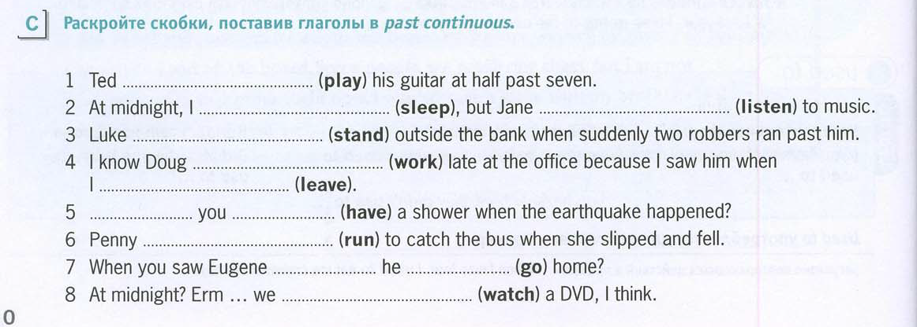

Slide 12
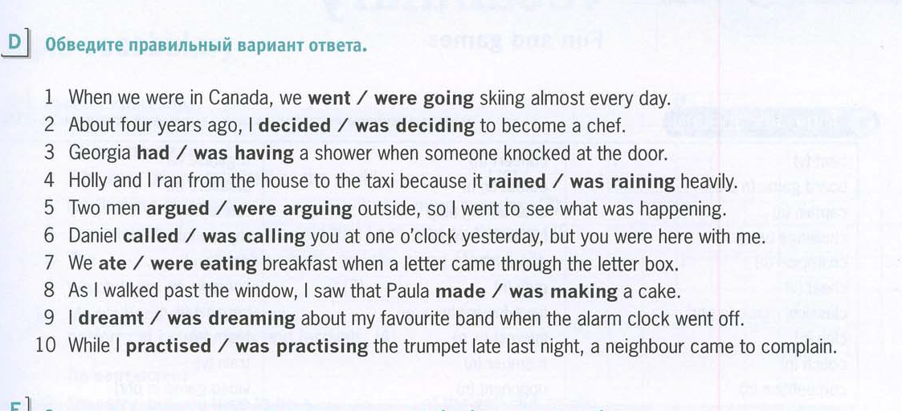

Slide 13
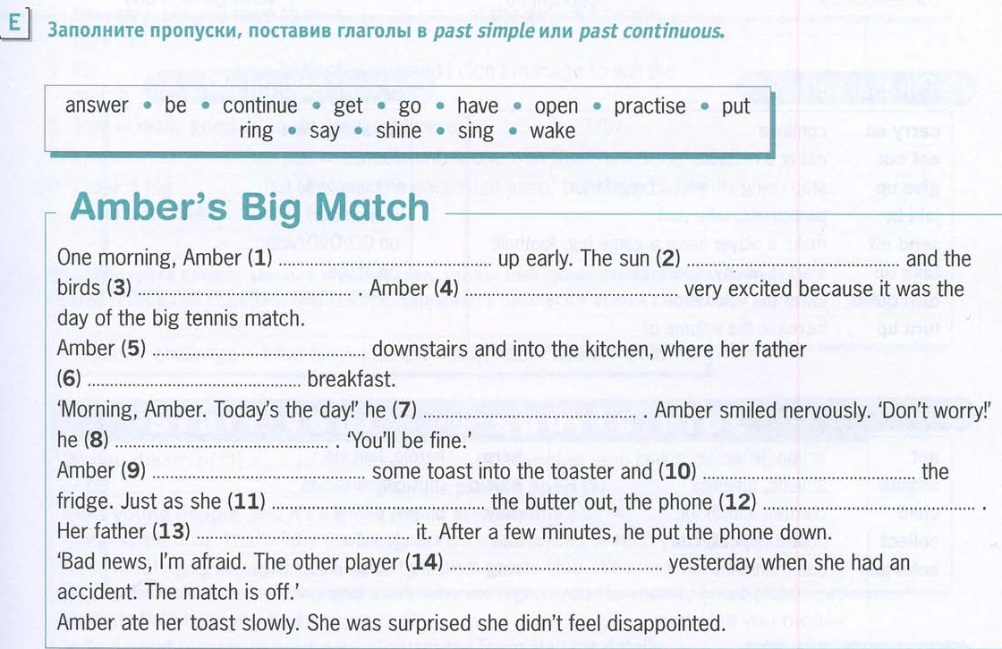

Slide 14
You can learn about Past more
https://www.youtube.com/watch?v=rZS5qlCGCIY
GOOD LUCK!

