Slide 1
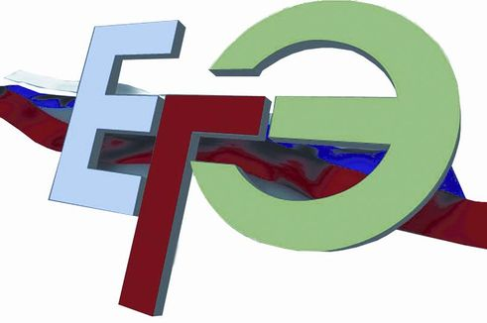

по английскому
Opinion essay

Slide 2

Критерии оценивания выполнения задания С2
(максимум 14 баллов)
К1 Содержание (3 балла)
  мнение выражено
  аргументы представлены
  выбран нейтральный стиль
К2 Организация (3 балла)
высказывание логично
структура текста соответствует предложенному плану
средства логической связи использованы правильно
текст разделён на абзацы

Slide 3
Критерии оценивания выполнения задания С2
(максимум 14 баллов)
К3 Лексика (3 балла)
словарный запас соответствует задаче
практически нет нарушений в использовании лексики
К4 Грамматика (3 балла)
грамматические структуры соответствуют поставленной задаче
практически отсутствуют ошибки
К5 Орфография и пунктуация (2 балла)
орфографические ошибки практически отсутствуют
пунктуационное оформление правильное

Slide 4
Many young people decide to become vegetarians. However, some people are unsure whether being a vegetarian is a healthy way to live.
What is your opinion? Do you agree with this statement?
Write 200–250 words.
Use the following plan:
make an introduction (state the problem)
express your personal opinion and give 2–3 reasons for your opinion
express an opposing opinion and give 1–2 reasons for this opposing opinion
explain why you don’t agree with the opposing opinion
make a conclusion restating your position

Slide 5
1.Make an introduction/state the problem
Nowadays more and more young people are becoming /getting… The question we need to answer is… My view is that…
2. Express your personal opinion and give 2–3 reasons for your opinion
My view is that …To begin with… Moreover…
3. Express an opposing opinion and give 1–2 reasons for this opposing opinion.
However … They maintain … As… Consequently…

Slide 6
4. Explain why you don’t agree with the opposing opinion.
They forget, however,… According to…
5. Make a conclusion restating your position
On balance…In spite of the opinion…I strongly believe
While …

Slide 7

Many young people decide to become vegetarians. However, some people are unsure whether being a vegetarian is a healthy way to live. What’s your opinion? Do you agree or disagree?

Slide 8
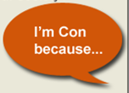

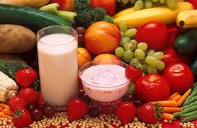
Many young people decide to become vegetarians
  4p not all the microelements and proteins>> serious health disorders
  2p a healthy balanced diet>> to grow up physically strong and mentally alert;
  not to result in fatigue, apathetic behaviour, loss of concentration
  3p more vitamins and less calories; staying in shape

Slide 9
1.Make an introduction/state the problem
Nowadays more and more young people are becoming vegetarians for a number of reasons. The question we need to answer is whether being a vegetarian is a healthy way to live. My view is that eating only vegetables and fruit might not be the right choice.

Slide 10
2. Express your personal opinion and give 2–3 reasons for your opinion
To begin with, our body needs a healthy balanced diet of vitamins, proteins and carbohydrates. All these substances are necessary for young people to grow up physically strong and mentally alert. Moreover, avoiding eating meat and fish can result in fatigue, apathetic behaviour and loss of concentration.

Slide 11
3. Express an opposing opinion and give 1–2 reasons for this opposing opinion
However, a lot of young people tend to stop eating meat to become healthy. They maintain that meat- free diet is more beneficial as it includes more vitamins, minerals , fibre and contains less calories than a meat-based diet. Consequently, it is the easiest way to stay in shape without doing any exhausting exercise.

Slide 12
4. Explain why you don’t agree with the opposing opinion
They forget, however, that such a diet does not contain all the microelements and proteins which are necessary for people and may cause serious health disorders. According to nutritionists it is essential to eat red meat at least once a week and fish two or three times a week because it is difficult to find a substitute to animal products.

Slide 13
5. Make a conclusion restating your position
On balance, in spite of the opinion that a meat -free diet brings benefits to people, I strongly believe we should not ignore the nutritional value of a meat-based diet. While choosing this or that lifestyle a person should take into consideration the importance of a proper diet which does not do any harm to his organism.

