Slide 1
Baikal Tour
Islands of lake Baikal

Slide 2
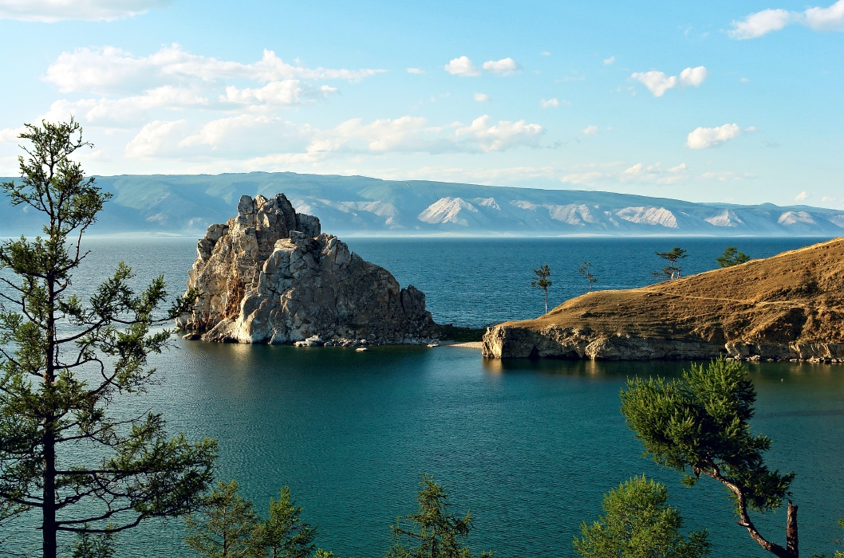
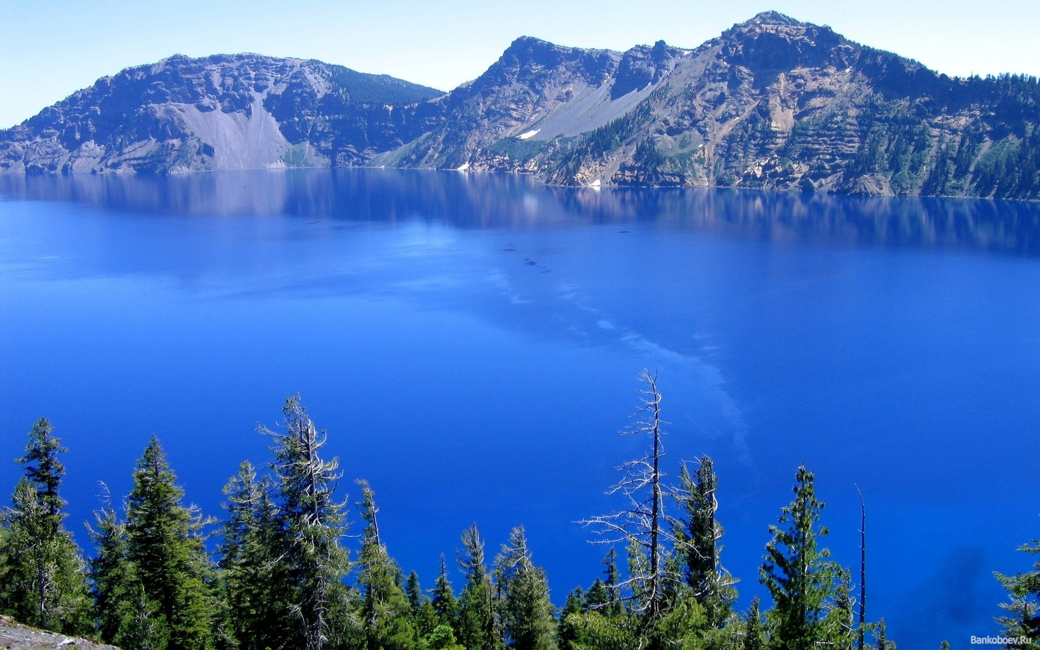
Introduction
We want to present you our project.
Lake Baikal is one of the most exciting travel destinations.
There are many beautiful landscapes, amazing animals and hospitable people.
So we’d like to invite you to our trip.

Slide 3
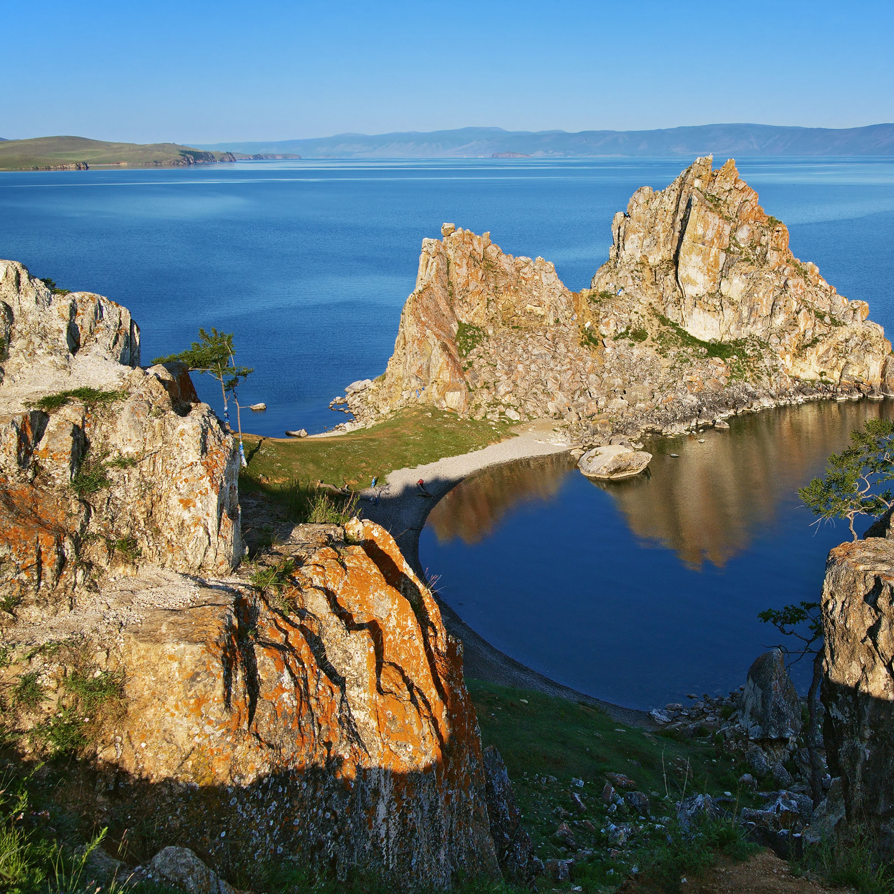
Schedule of our trip
Our trip will take 2 days.
We’ll visit 2 islands of lake Baikal.
The 1st day: Ushkany islands
The 2nd day: Olkhon island
Let’s start!

Slide 4
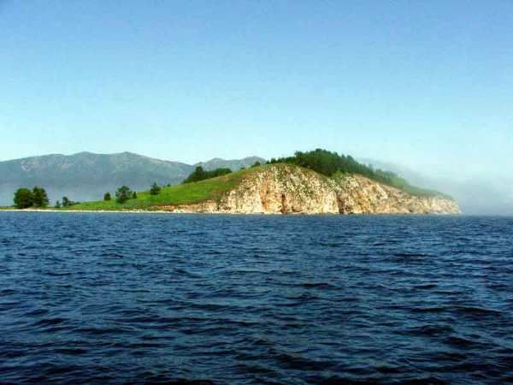
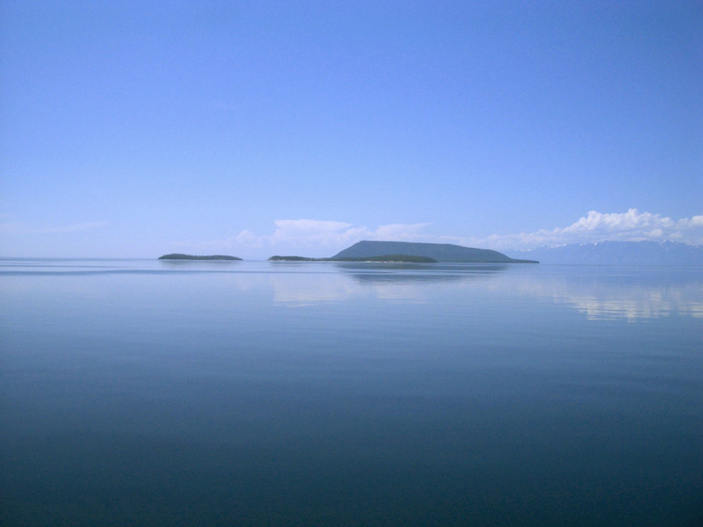
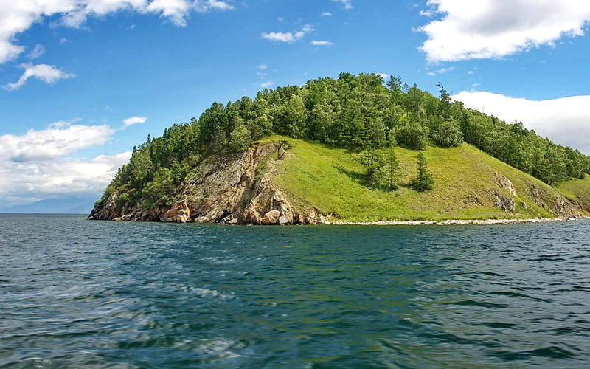
The 1st day: Ushkany Islands
We’ll visit Ushany Islands on the 1st day.
A part of Transbaikal National Park, the Ushkan Islands are becoming a popular tourist destination.

Slide 5
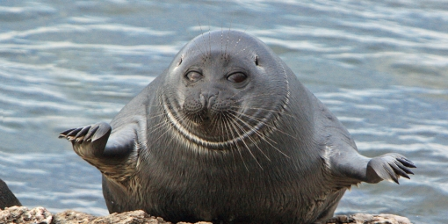
The 1st day: Ushkany island
The ushkany Islands take their name from the world “ushkan”. They are famous for their seal rookeries, and they have the curious names of “Big”, “Thin”, “Round” and “Long”.

Slide 6
The 1st day: Big Island
Big Island is the biggest of the Ushkany Islands. It has huge 300 years-old larches and pine trees.
It is also famous for its ant hills, which are almost unique in Russia.

Slide 7
What will we do? What will we see?
Ushkany Islands are a great place for leasure.
First, there’re amazing nature and landscapes.
Secondly, Islands’ coastlines are rookery places of Baikal seals. So if you want to see this endemic animal, the Ushkany Islands are the best place for you.
Next, there are almost unique ant hills and huge 300 years-old larches.
I’m sure you’ll amazed because the Ushkany Islands are really fastinating place for tourists.

Slide 8
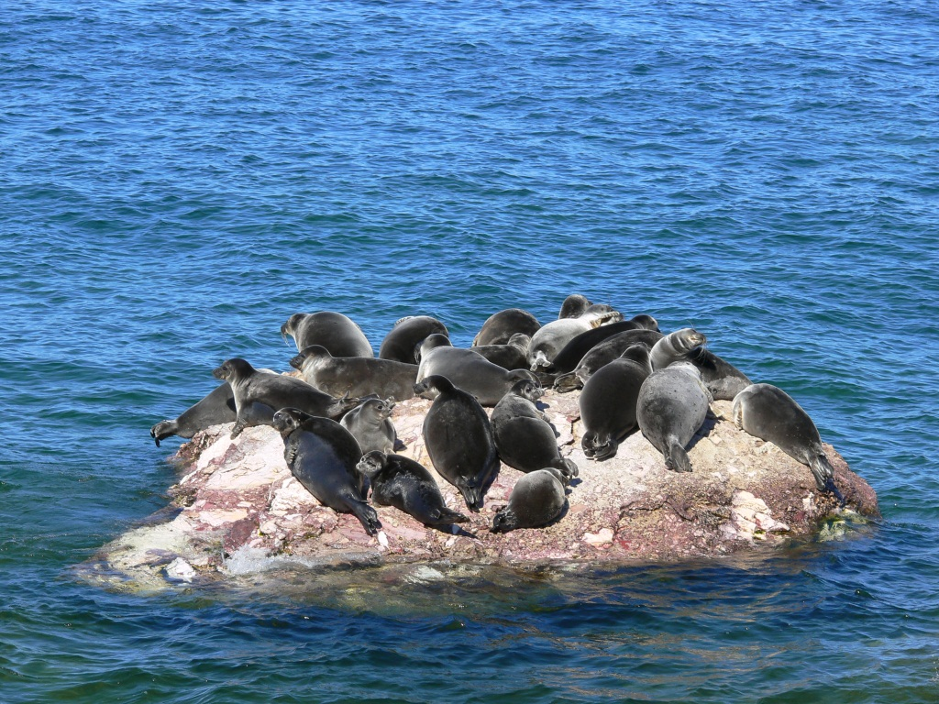
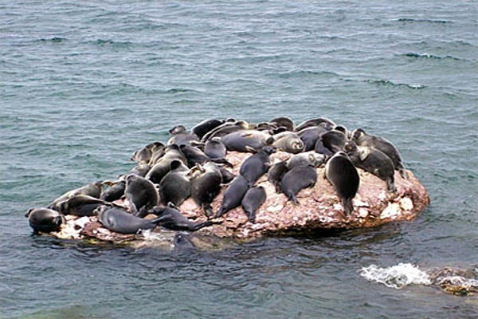
Rookery places of Baikal seals
There are some photos of Baikal seals.

Slide 9
The 2nd day: Olkhon Island
We’ll visit Olkhon Island on the 2nd day.
Olkhon Island is the biggest island on lake Baikal. Perhaps, it’s the most interesting place for you because it is home to various, amazing animals and it is settled by people.
Olkhon Island is the only island on lake Baikal which is settled by people. About 1,500 people inhabit Olkhon today, and the live mainly from fishing and cattle breeding.

Slide 10
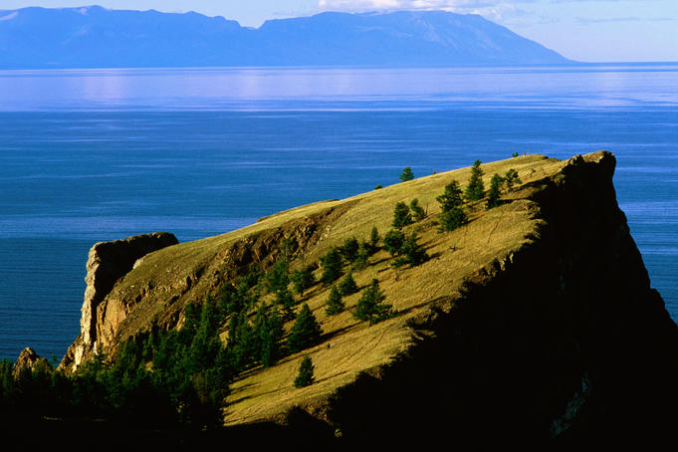
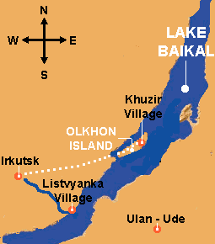
The 2nd day: Olkhon Island

Slide 11
The 2nd day: Olkhon Island
You might be interested to know what birds and animals live on the island.
Olkhon Island is home to various animals, including lynx, fox and others, as well as endemic species, the olkhon vole (полевка).
Besides, Baikal seals can sometimes be seen along the Olkhon coastline.

Slide 12
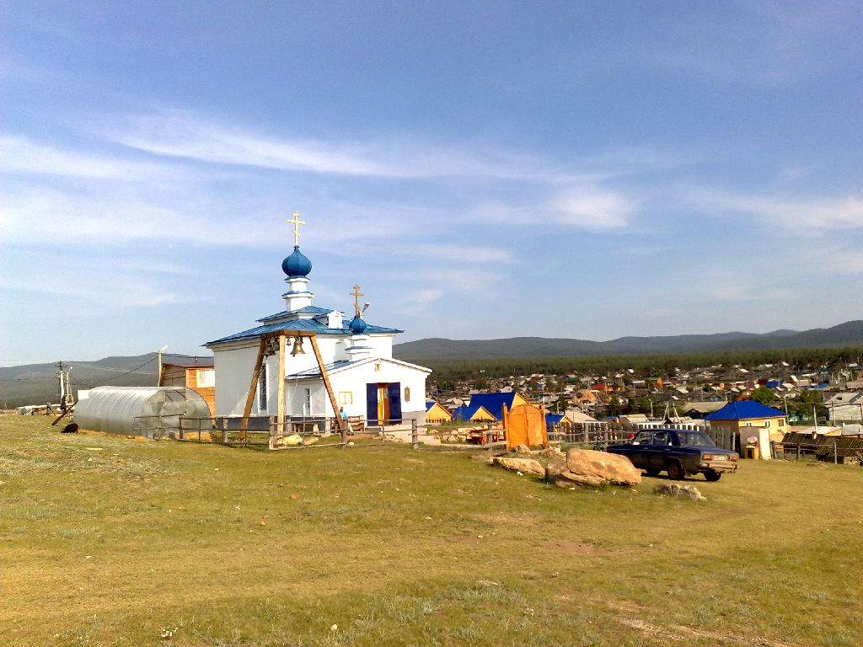
The 2nd day: Olkhon Island
Olkhon Island is a magnificent place!
There are hospitable people, amazing animals, beautiful nature and landscapes and even tourist attractions, for example The National History Museum of Revyakin N.M.

Slide 13
Places of Interest
The National History Museum of Revyakin N.M.;
Peschanaya Village;
Three Brothers Rock, or Sagaan-Khushun Cape;
Khoboy Cape;
Cape of Khargoy.
These places you can visit on Olkhon Island.

Slide 14
What will we do? What will we see?
There are:
wonderful nature;
different animals;
tourist attractions;
beautiful landscapes.
I’m sure you will enjoy visiting this island.

Slide 15
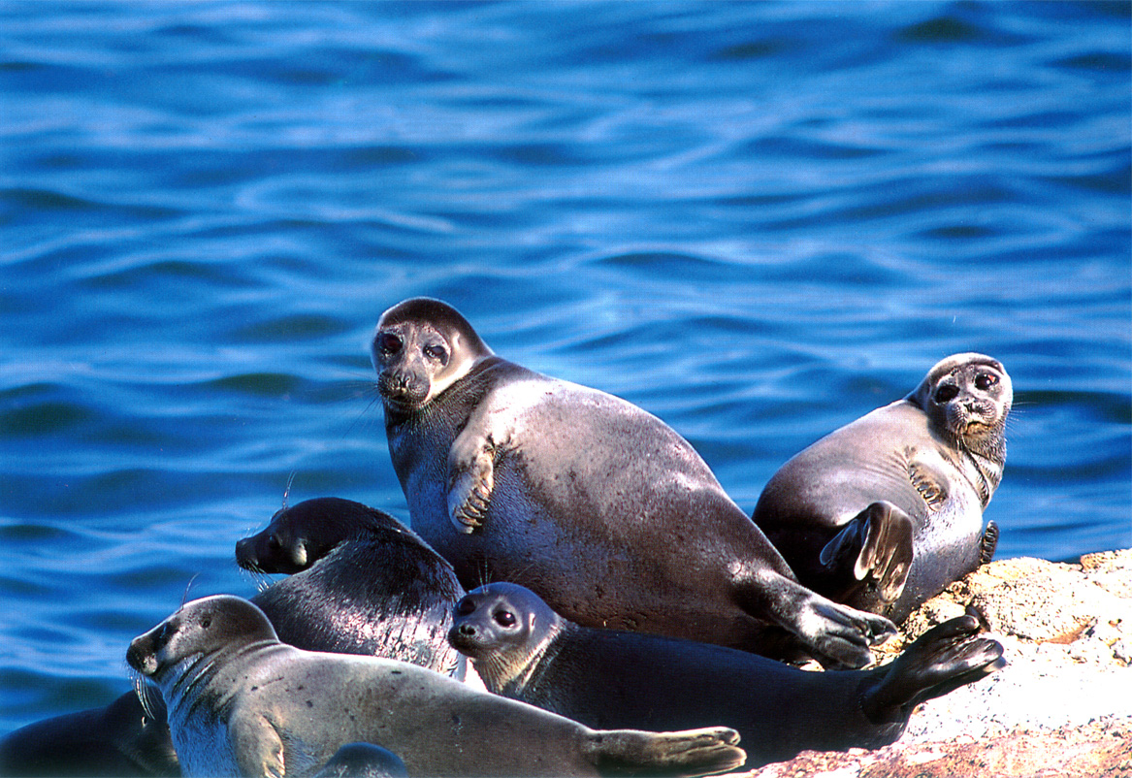
In conclusion
Lake Baikal is a really wonderful place.
Islands of Baikal are exciting, too.
We invite you to our trip. It takes 2 days and we’ll visit 2 islands.
You will enjoy this travelling. Join us!

