Slide 1
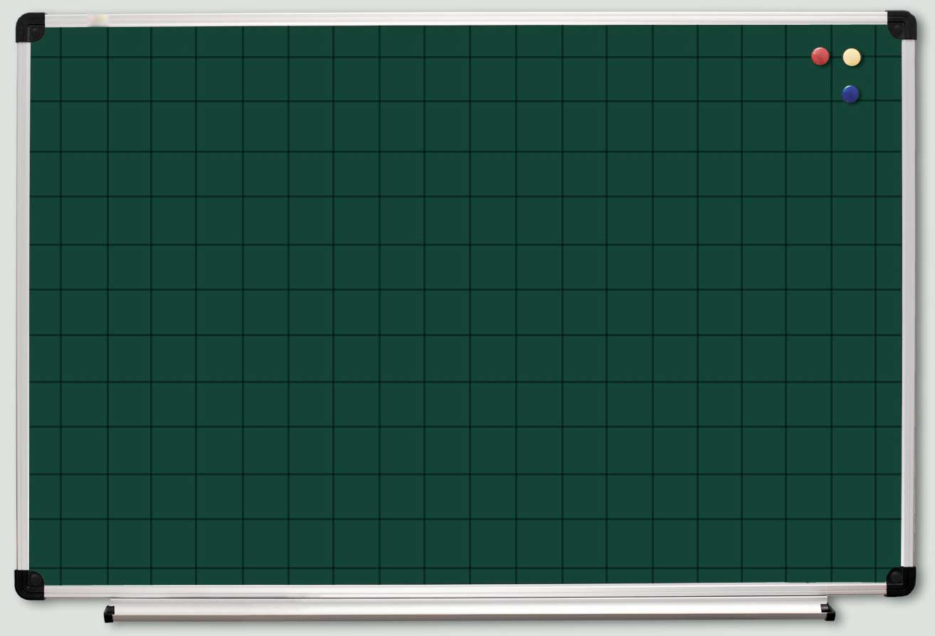




Slide 2






45
48
28
9 ⋅ 5
8 ⋅ 6
7 ⋅ 4
54
35
32
9 ⋅ 6
7 ⋅ 5
8 ⋅ 4
30
40
16
6 ⋅ 5
5 ⋅ 8
4 ⋅ 4

Slide 3

14
27
3 ⋅ 5
2 ⋅ 7
3 ⋅ 9
15
24
6 ⋅ 6
56
8 ⋅ 3
36
7 ⋅ 8
81
5 ⋅ 4
24
9 ⋅ 9
20
4 ⋅ 6

Slide 4


7 ⋅ 7
49
24
32
4
3 ⋅ 8
4 ⋅ 8
2 ⋅ 2
56
63
24
8 ⋅ 7
9 ⋅ 7
6 ⋅ 4
18
30
3 ⋅ 6
5 ⋅ 6

Slide 5


8
2 ⋅ 4
72
35
9 ⋅ 8
5 ⋅ 7
18
36
6 ⋅ 3
7 ⋅ 6
9 ⋅ 4
42

Slide 6


14
6 ⋅ 9
7 ⋅ 2
4 ⋅ 5
54
20
16
8 ⋅ 2
45
9 ⋅ 2
42
5 ⋅ 9
18
6 ⋅ 7
9
40
3 ⋅ 3
21
8 ⋅ 5
7 ⋅ 3

Slide 7

10
5 ⋅ 2
18
2 ⋅ 9
6
2 ⋅ 3
12
16
2 ⋅ 6
2 ⋅ 8
28
15
4 ⋅ 7
8
5 ⋅ 3
12
4 ⋅ 2
12
3 ⋅ 4
6 ⋅ 2

Slide 8



48
63
64
27
25
6 ⋅ 8
7 ⋅ 9
8 ⋅ 8
9 ⋅ 3
5 ⋅ 5
2 ⋅ 5
12
36
72
21
10
4 ⋅ 3
4 ⋅ 9
8 ⋅ 9
3 ⋅ 7

