Slide 1
Project
“Subtle English humor. Comparative characteristics of the English jokes and the Russian anecdotes.”
Made by the pupil of the 8th form
Ekperov Muslim (89613242009)
Supervisor: Bushina O.V.

Slide 2
The aim
To compare English jokes and Russian anecdotes

Slide 3
The tasks
to study and analyze English jokes and Russian anecdote;
to find out their differences and similarities.

Slide 4
The hypothesis
Jokes of different countries reflect cultural peculiarities.

Slide 5
Types of English jokes
the elephant jokes
dry sense of humour
banana skin sense of humour
shaggy-dog stories
Puns
“Black humour”

Slide 6
The elephant jokes
How does the ocean say hi? It waves!
How can you tell that an elephant has been in your refrigerator? - By the footprints in the butter.

Slide 7
Dry sense of humour
Experience is simply the name we give our mistakes.
Our local fire station burnt down last night.
Two men are talking in London:
What's your last name?
Shakespeare.
Oh, this name is well known.
- Of course! I've been breeding cows in this area for twenty years.

Slide 8
Shaggy-dog stories
Sherlock Holmes and his friend Watson were on a camping and hiking trip. They had gone to bed and were lying there looking up at the sky. Holmes said, «Watson, look up. What do you see?» «Well, I see thousand of stars». «And what does that mean to you?» «Well, I guess it means we will have another nice day tomorrow. What does it mean to you, Holmes?» «To me, it means someone has stolen our tent».

Slide 9
Puns
- Will you tell me your name?
- Will Knot.-
Why not?
I wondered why the ball was getting bigger. Then it hit me!
- Why do people wear shamrocks on St. Patrick’s Day?
- Regular rocks are too heavy.

Slide 10
Black humour
A commercial traveler was passing through a small town when he came upon a huge funeral procession.
"Who died?" he asked a nearby local.
"I'm not sure," replied the local, but I think it's the one in the coffin. "
Today, I asked my phone “Siri, why am I still single?” and it activated the front camera.

Slide 11
Similarities
Self-deprecation.
Relation to different spheres of life.
Reflection of cultural peculiarities.

Slide 12
Differences
Cultural peculiarities.
The manner of telling the joke.

Slide 13
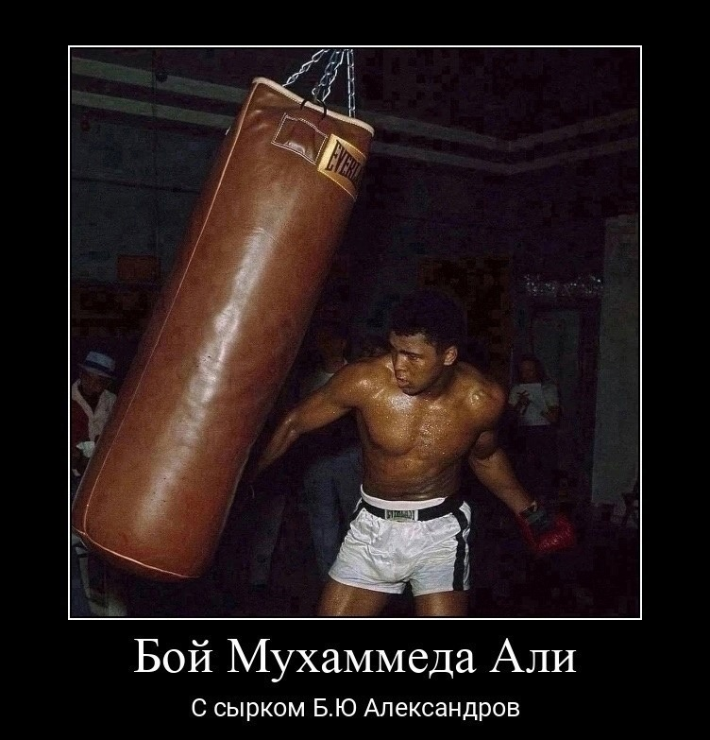
Examples of memes

Slide 14
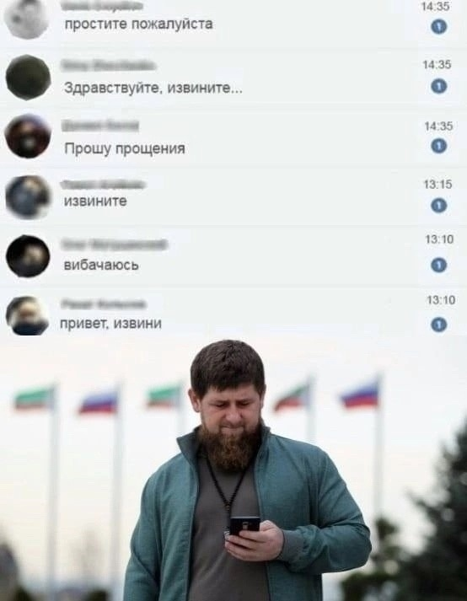

Slide 15
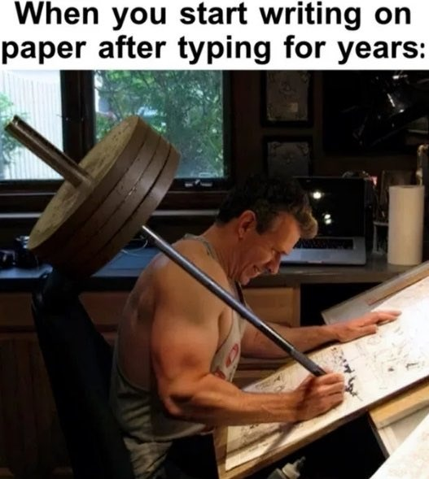

Slide 16
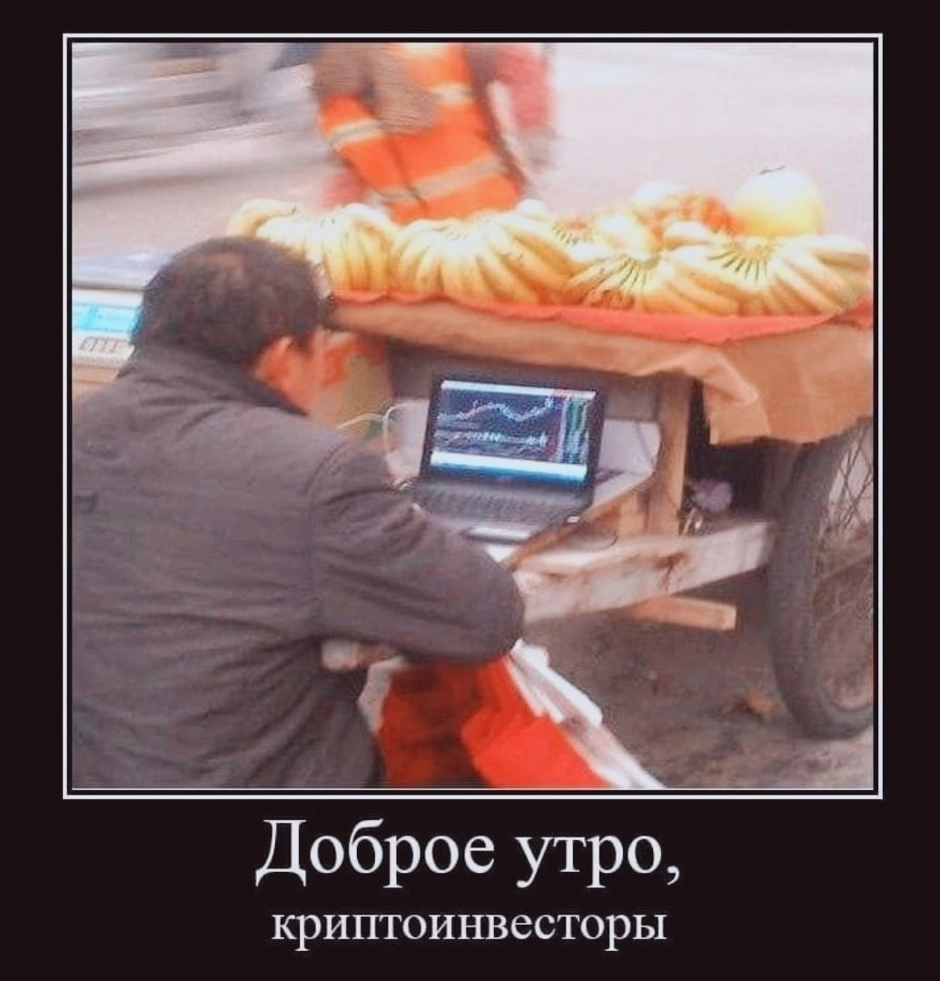

Slide 17
The questions of the poll
Who watches memes?
Who tells jokes?
Who would prefer a joke to a meme?

Slide 18
Results of the poll

Slide 19
Conclusion
To understand jokes, it is necessary to have certain basic knowledge of the language, stereotypes, certain peculiarities of national character.

Slide 20
THANK YOU
FOR
YOUR ATTENTION

