Slide 1
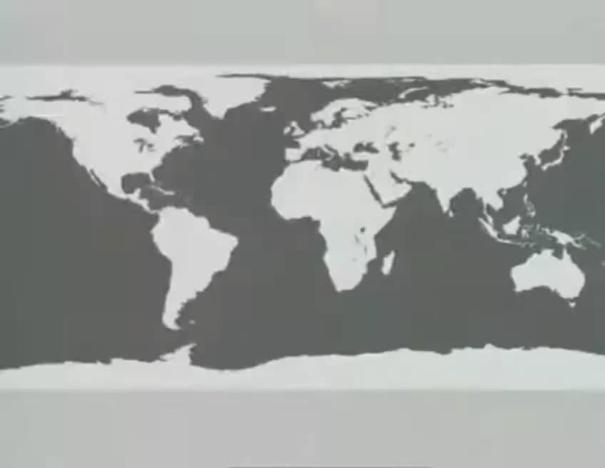


Slide 2
Project
“Banknotes as a reflection of the history of Europe, Asia, and Russia.”
Made by the pupils of the 8th form:
Volodin Alexander +7 (928) 114 16-04;
Zaripov Nail +7 (989) 710 04-08
Supervisor: Bushina O.V.
School №24,

Slide 3
The purpose
To find out whether the study of banknotes can help expand our knowledge on the history and culture of Russia, England and China

Slide 4
The tasks
To find and study information about modern banknotes of the Russian Federation, the United Kingdom and the Chinese National Republic.
To compare modern banknotes of these three countries.

Slide 5
The hypothesis
Banknotes can be an additional source when studying the history.

Slide 6
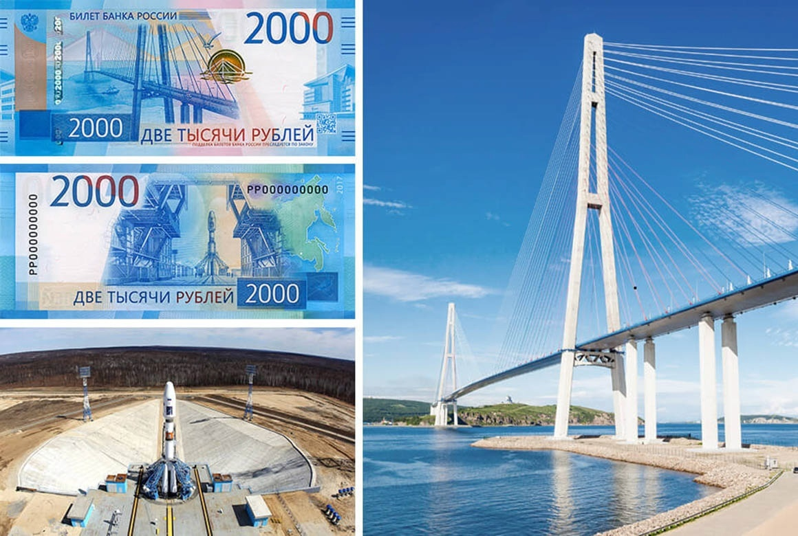
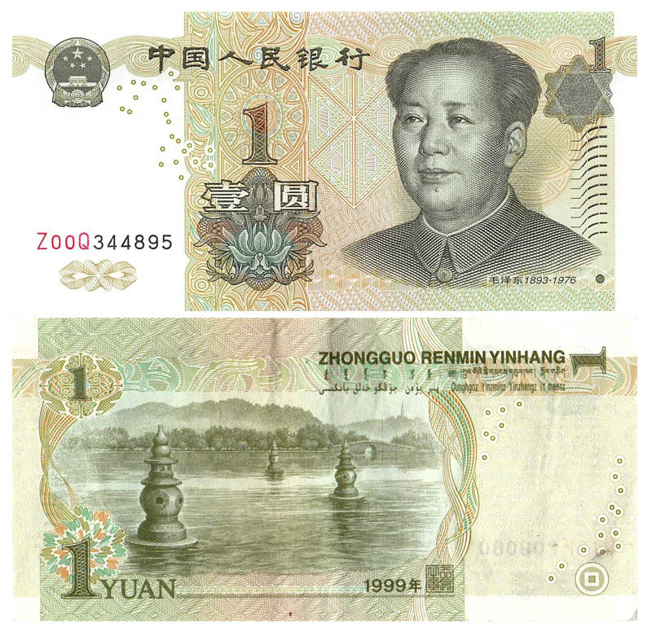
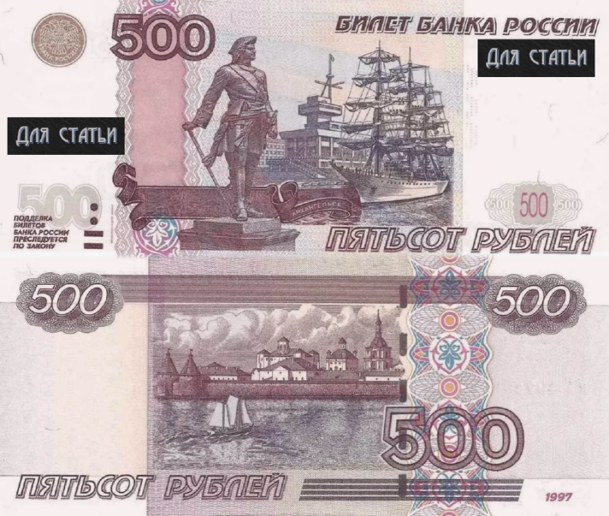
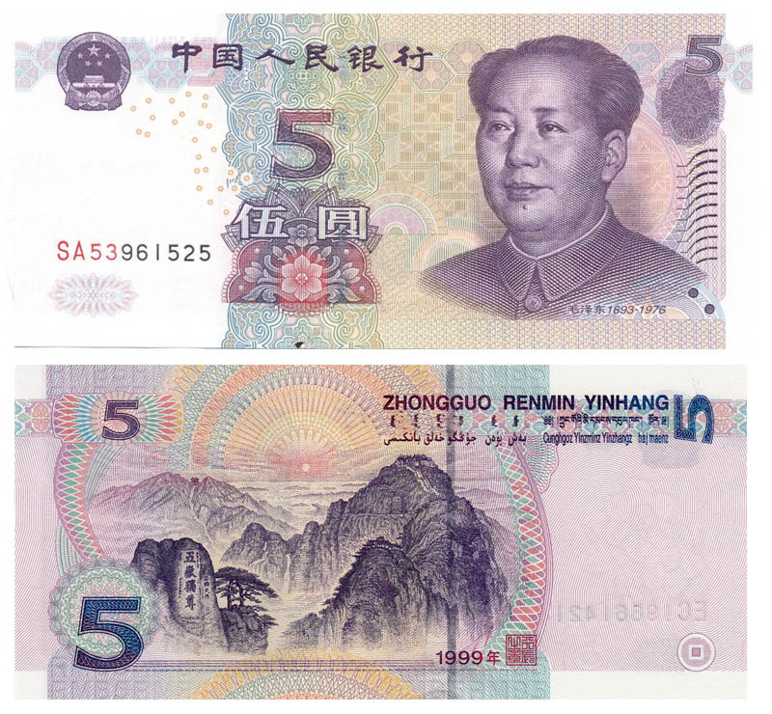
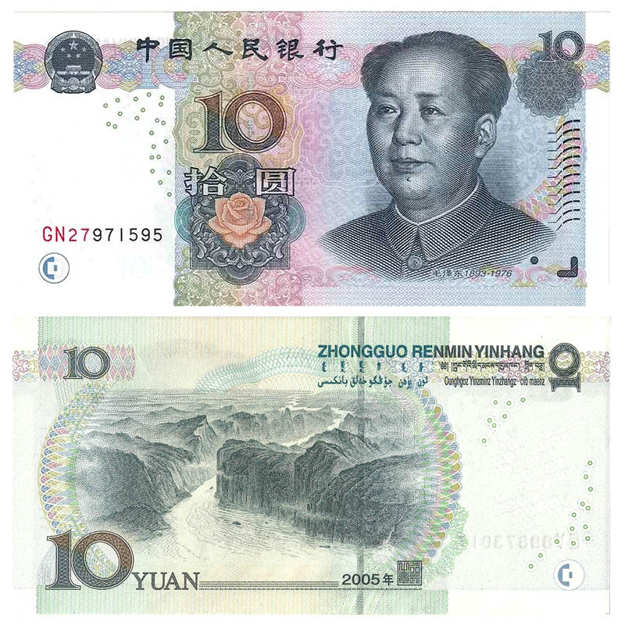
Chinese and Russian money with images of places мест

Slide 7
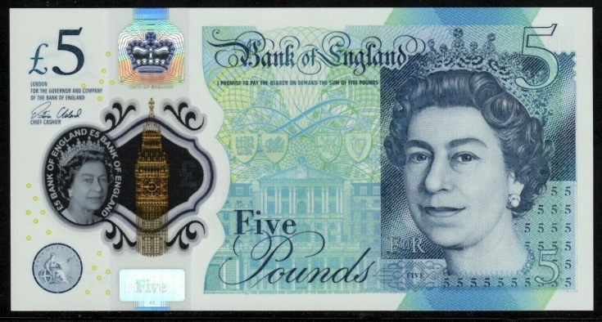
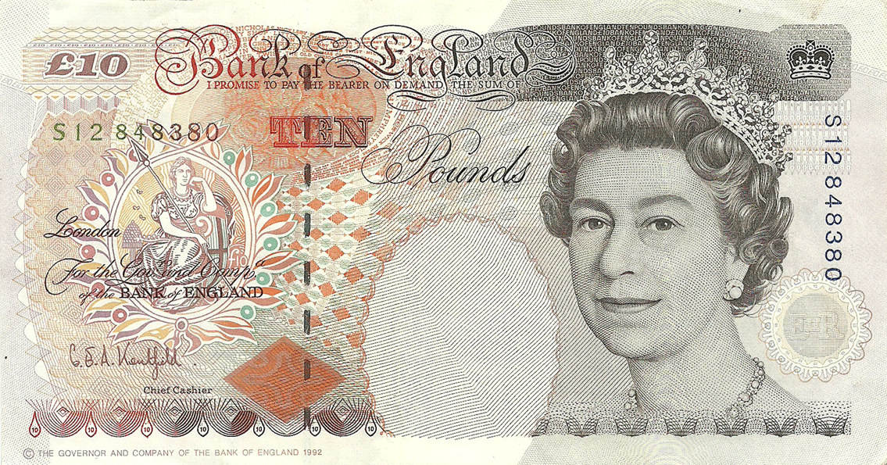
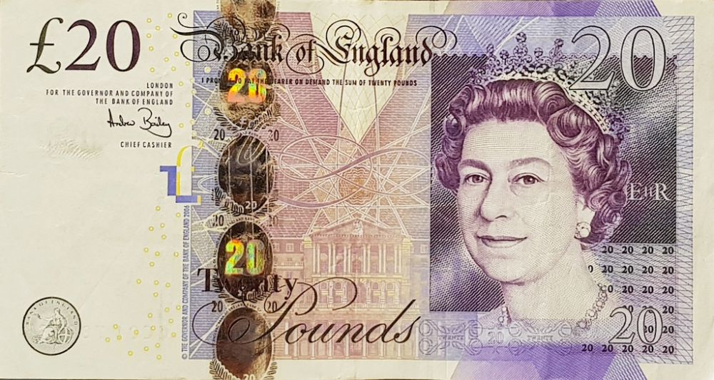
Chinese and british banknotes with portraits of leaders

Slide 8
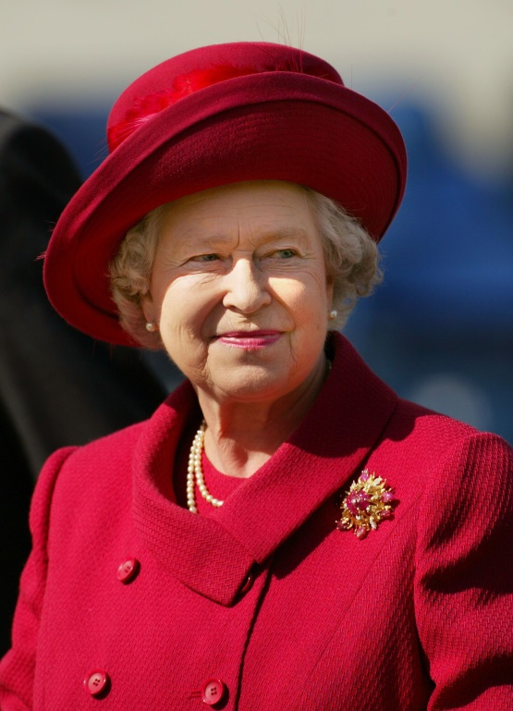
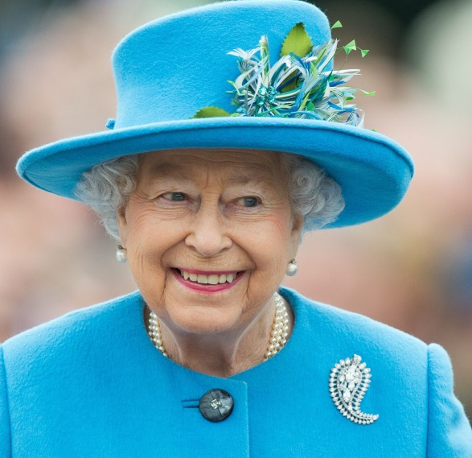
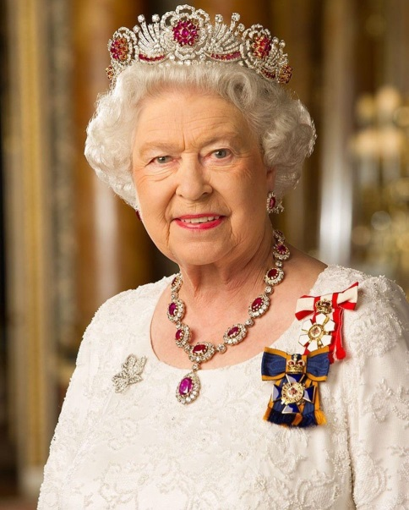
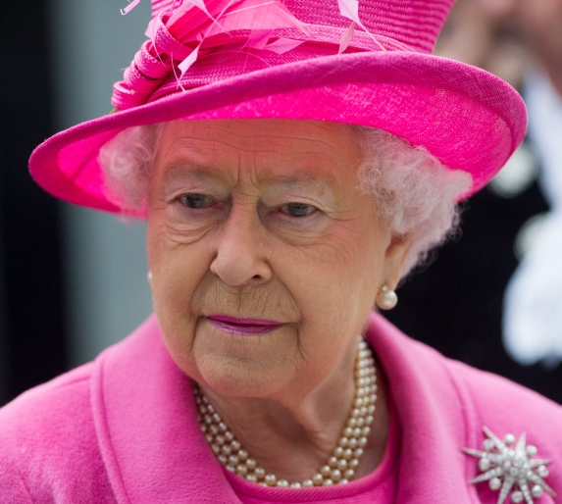
Elizabeth II

Slide 9
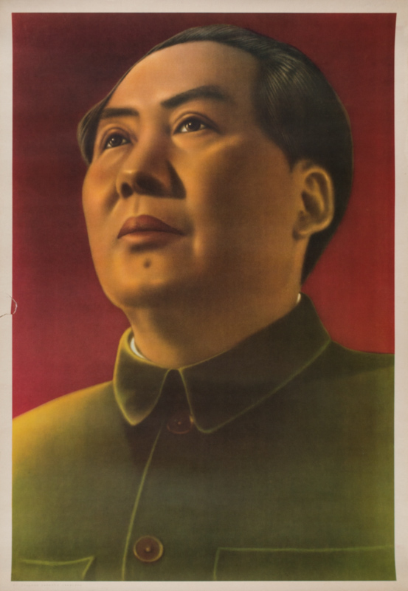
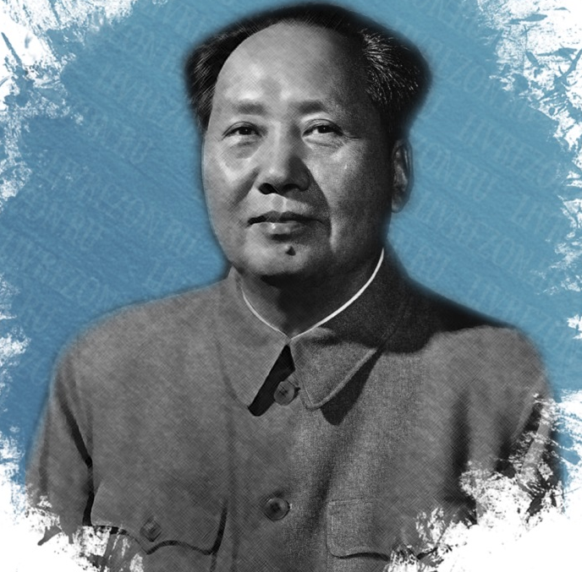
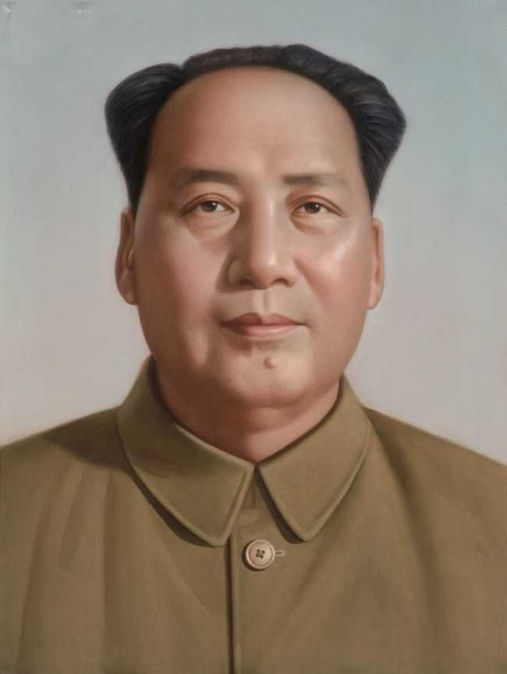
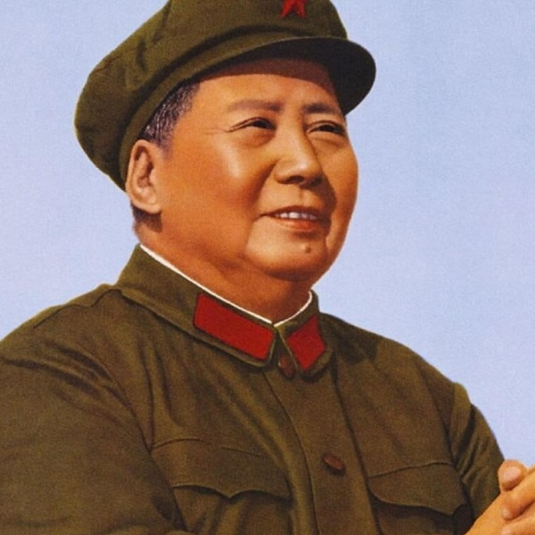
Mao Zedong

Slide 10
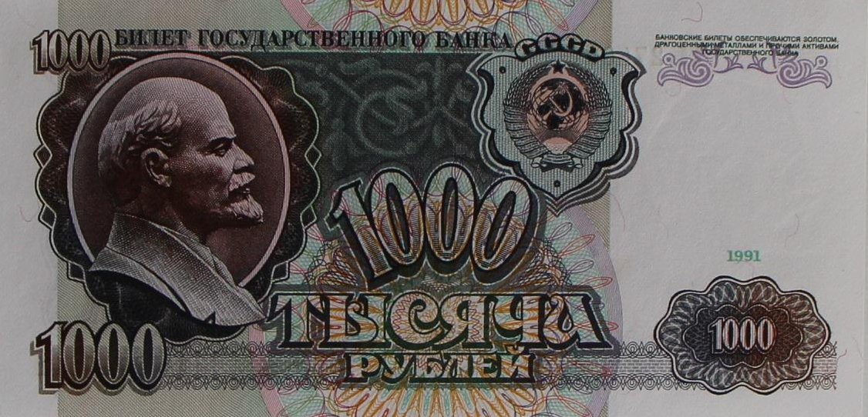
Banknote with Lenin

Slide 11
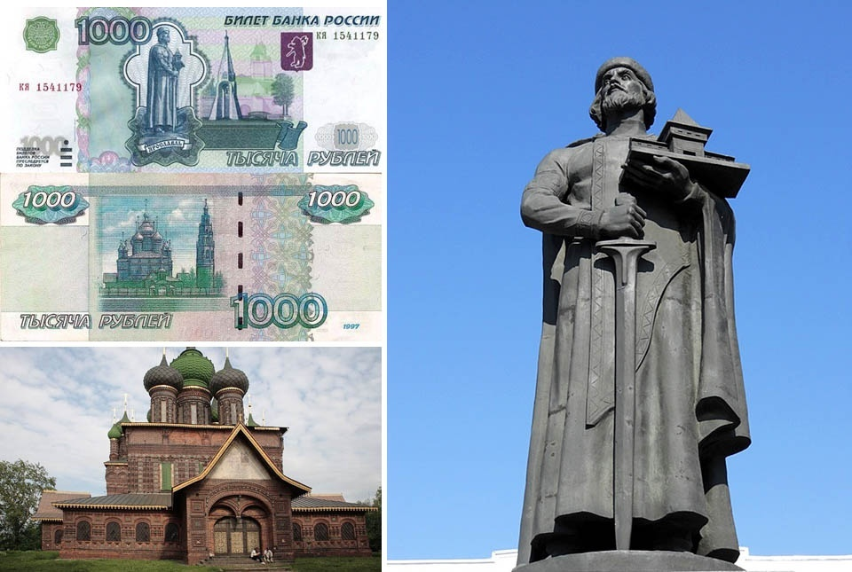
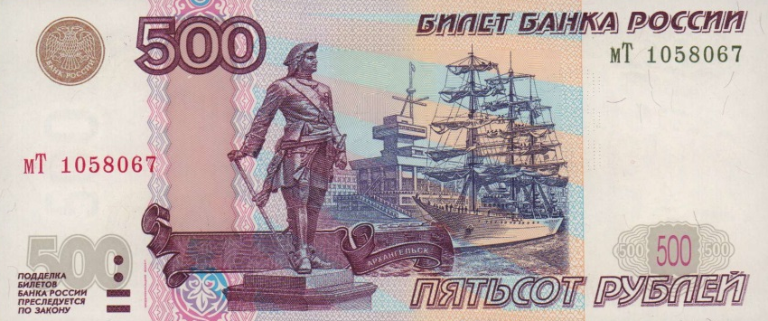
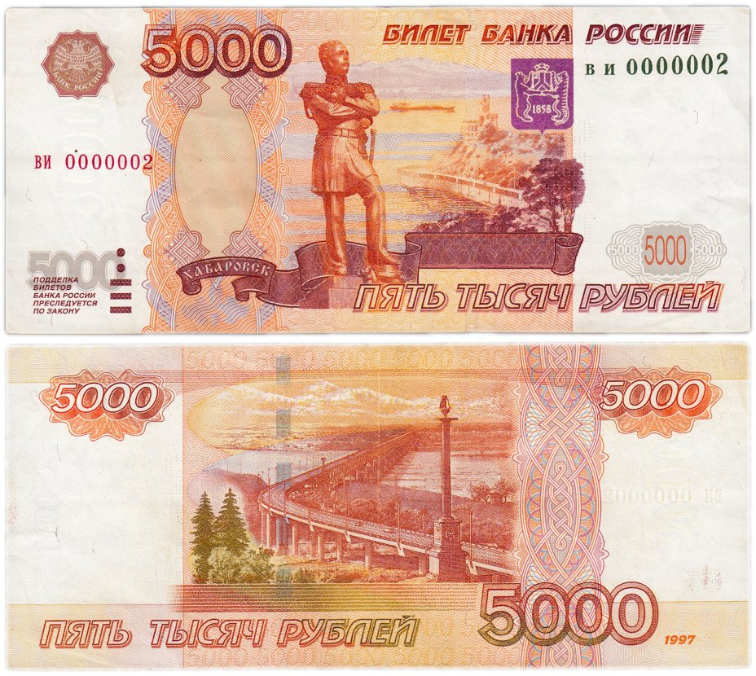
Banknote with statues of Amursky, yroslav fnd peter

Slide 12
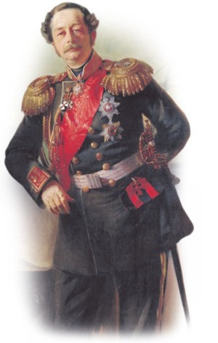
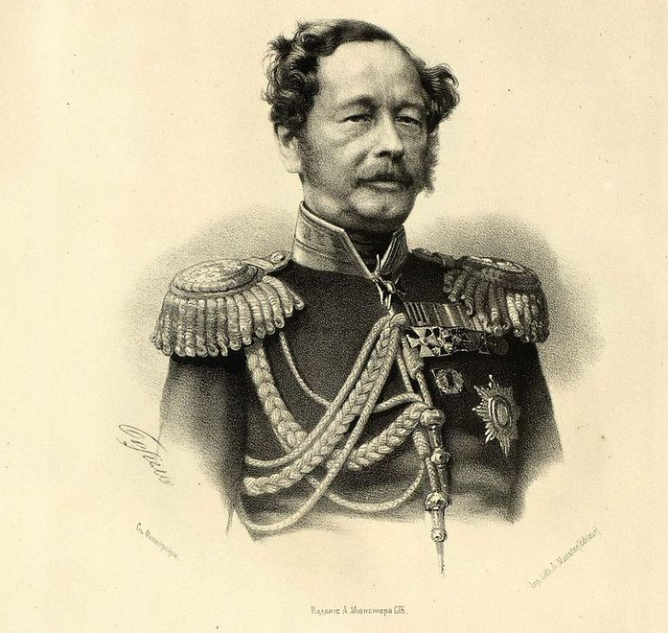
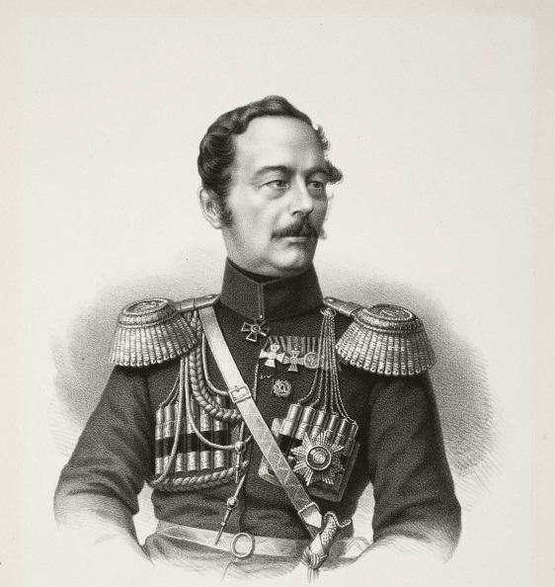
Muravyov-amursky

Slide 13
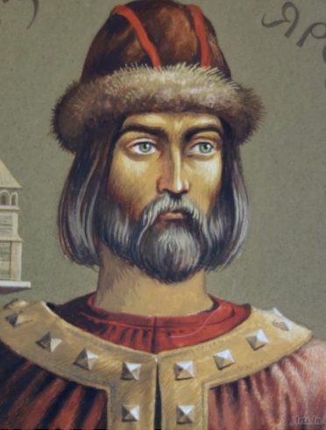
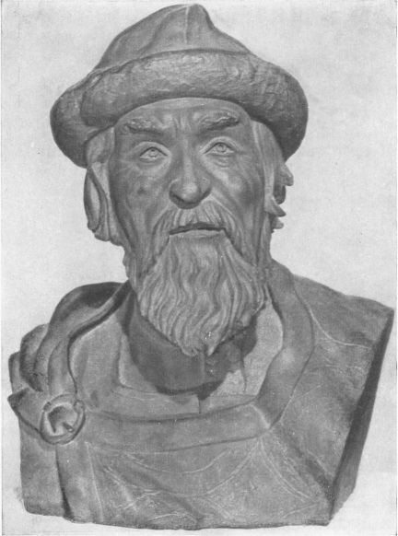

Yaroslav the wise

Slide 14
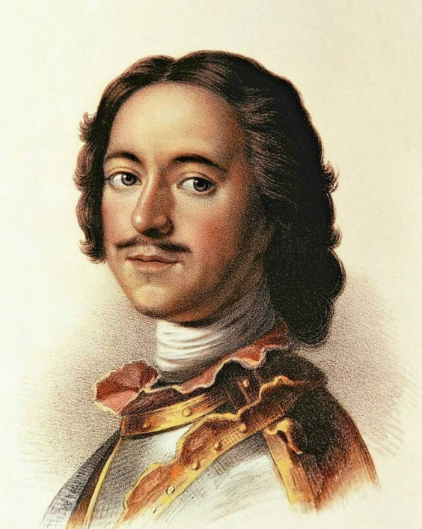
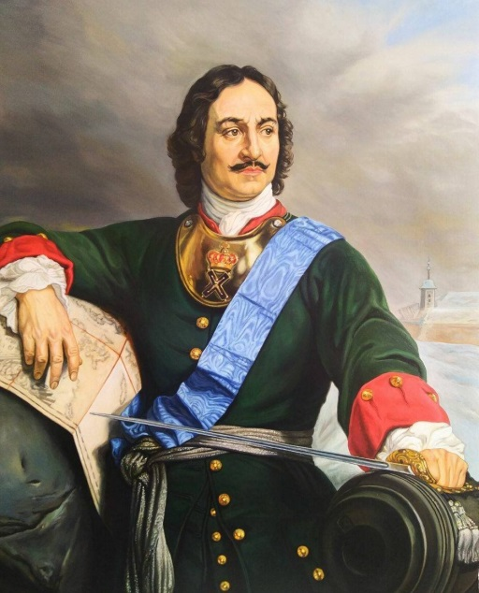
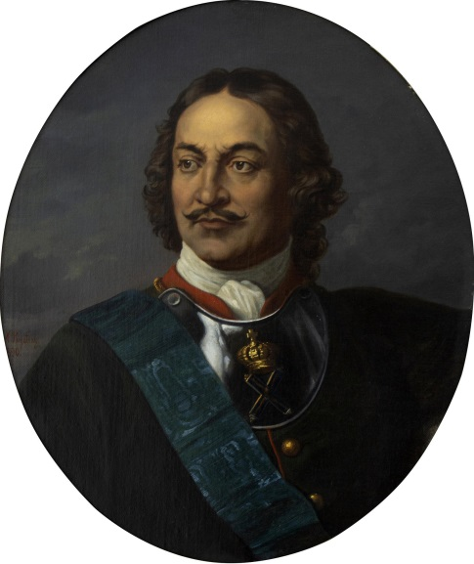
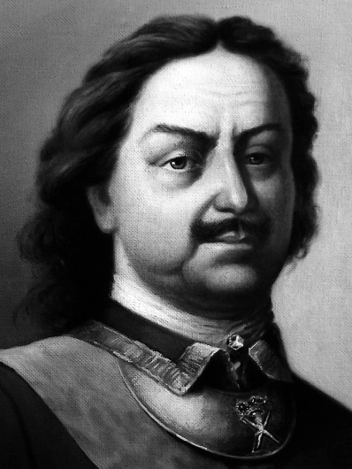
Peter i

Slide 15
Conclusion
Banknotes can be an additional source not only for studying history but also culture of the country.

Slide 16
Thank you for listening!

