Slide 1
English

Slide 2
Questions
Who is on duty today? - I am …
Who is absent today? - … is/are absent today.
What month is it now? – It is …now.
How many lessons have you got today? – We have got … … today.

Slide 3
Read the rhyme
B – A – Bay B – E – B
B – I – Bitty – By B – O – Bo
Bitty – By – Bo B – U – Bute
Bitty – By – Bo Bute - Bute

Slide 4
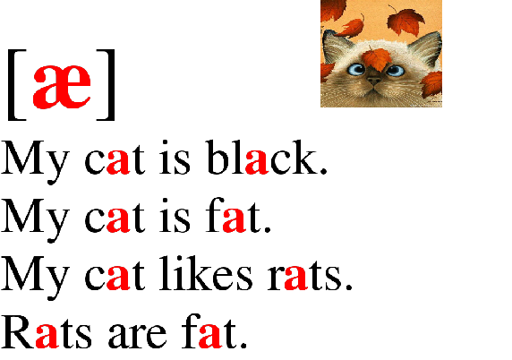

Slide 5
Vocabulary activation
Volleyball
Tennis
Hockey
Badminton
Cycling
Skating
Football
Swimming
Baseball
Table tennis

Slide 7
Playing sports
(types of sports)

Slide 8
Present Simple
Утвердительное предложение
V+
s
I | like
You | like
He | like
She | like
It | like
We | like
They | like
s
s
s

Slide 9
Choose the right form
Jessica (watch / watches) TV every evening.
Our teacher (read / reads) a lot of books.
My dad (drive / drives) to work every morning.
I (drink / drinks) a lot of water.
The children (play / plays) in the park.
We (live / lives) in a big house.
The boys (hate / hates) fish.

Slide 10
2.Вопросительное предложение
Do
I like ?
you like ?
he likes ?
she likes ?
it likes ?
we like ?
they like ?
Do
Does
X
Does
X
Does
X
Do
Do

Slide 11
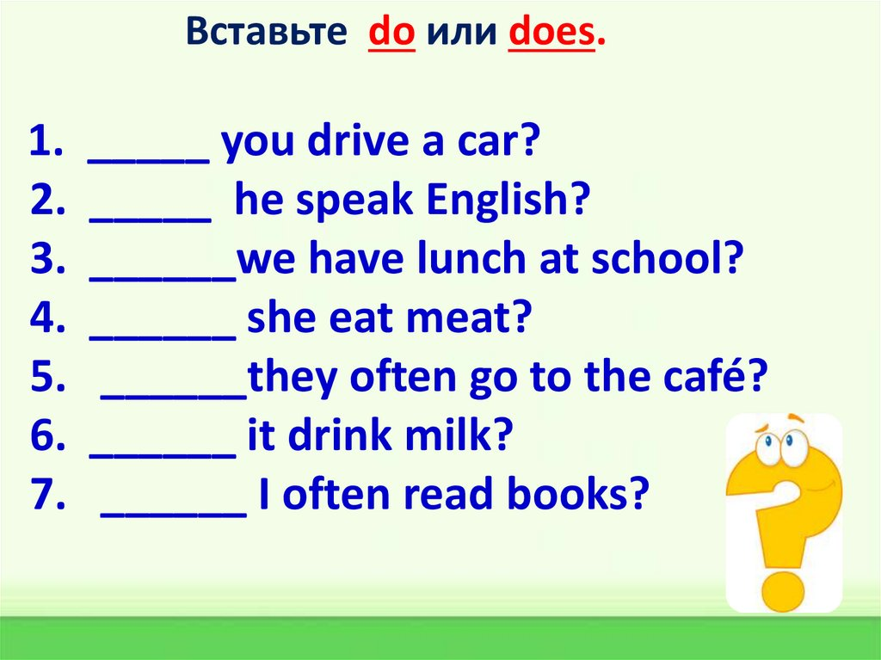
Вставьте do или does.
Do
Does
Do
Does
Do
Does
Do

Slide 12
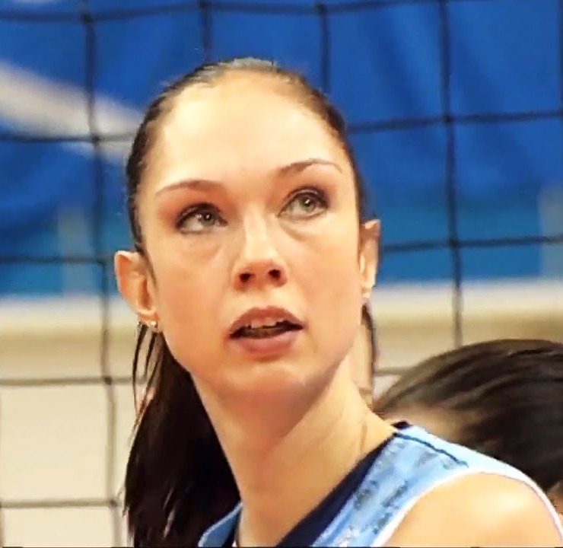
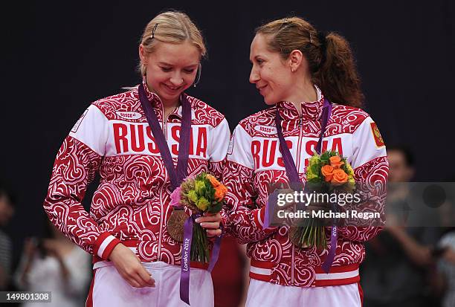
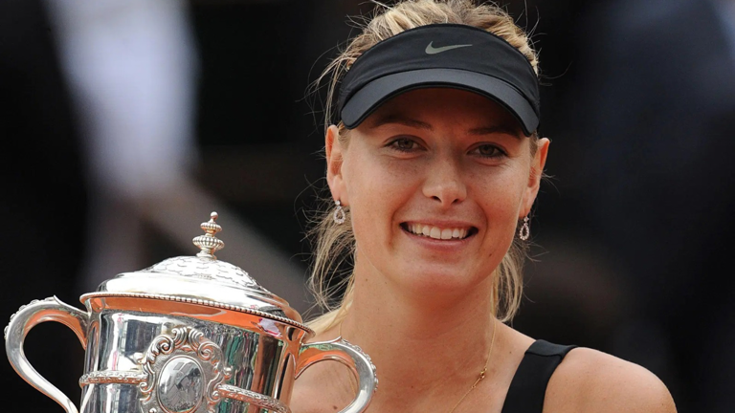
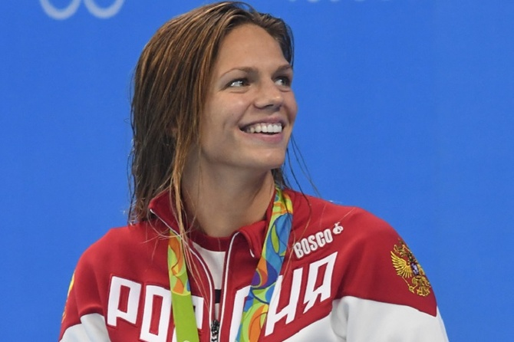
Volleyball - Ekaterina Gamova
Tennis - Maria Sharapova
Badminton - Valeria Sorokina and Nina Vislova
Swimming – Julia Efimova

Slide 13
3. Отрицательное предложение
don’t/
doesn’t
+ V
don’t
I | like
You | like
He | likes
She | likes
It | likes
We | like
They | like
don’t
doesn’t
X
doesn’t
X
doesn’t
X
don’t
don’t

Slide 14
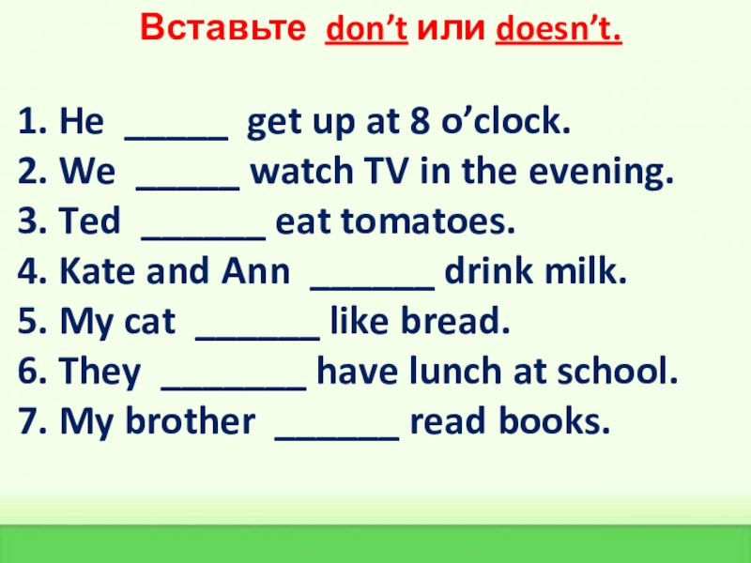
Вставьте don’t или doesn’t.
don’t
don’t
doesn’t
don’t
doesn’t
don’t
doesn’t

Slide 15
Homework
Make up 5 affirmative, negative and interrogative sentences
(Составить 5 утвердительных, отрицательных и вопросительных предложений)

Slide 16
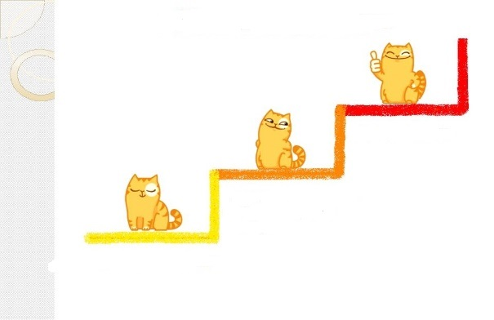
The ladder of success!
Very good - 5
Good - 4
Not bad - 3

